Slide 1
Websites and Apps for Vocabulary Learning and Teaching
Sam Barclay
Nottingham Trent University

Slide 2
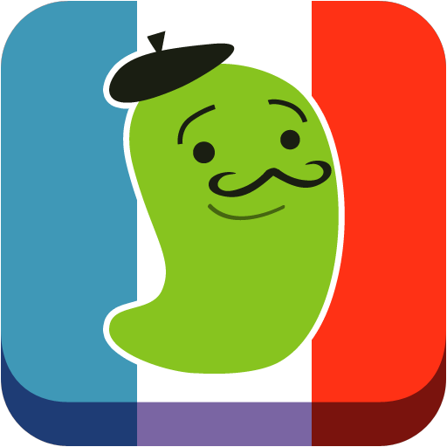
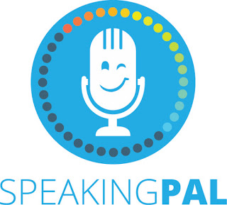

Slide 3
Notes:
hello

Slide 4
Resources for planning a class
Resources to use in class
Resources for students to use independently

Slide 5
Resources for planning a class
Resources to use in class
Resources for students to use independently

Slide 6
The identification of problematic words
Finding:
Teachers can be poor at predicting which words their learners know and don’t know.
Example(s):
Brutten, 1981; Riley and Whistler, 1999
Action:
Conduct a lexical frequency profile
www.lextutor.ca/vp/

Slide 8
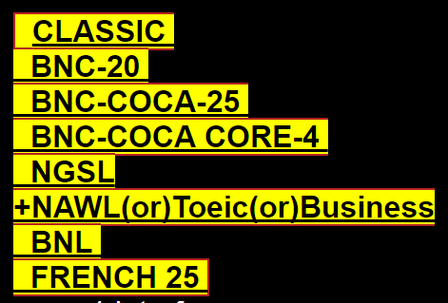

Slide 9
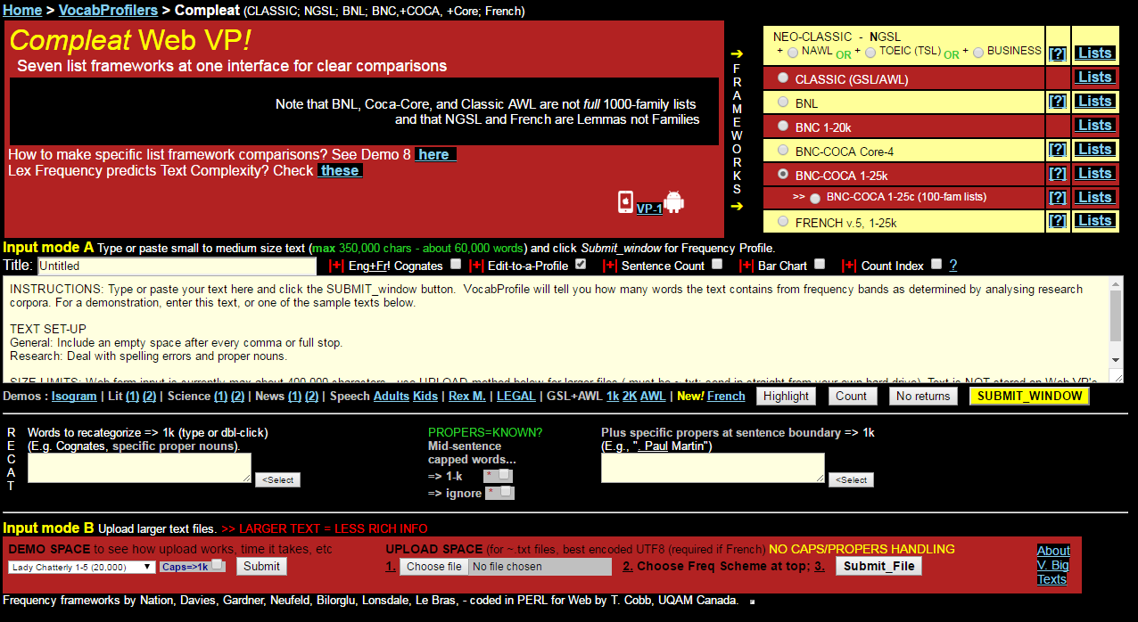

Slide 11
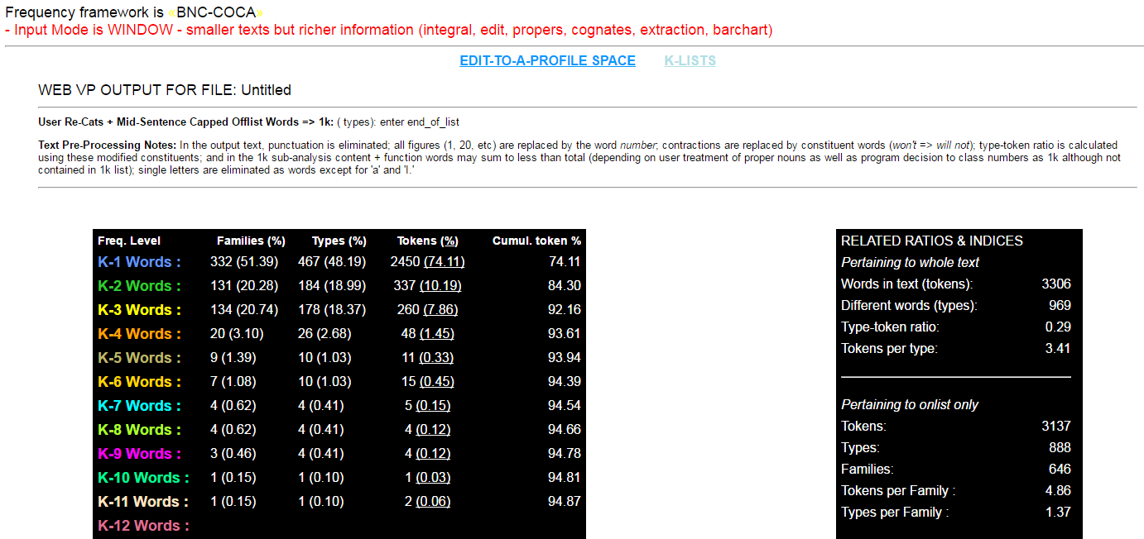

Slide 13
Notes:
Different ways of finding potentially problematic words – in the text, or by frequency level. Also shows number of times each word occurs in the text. This would allow you to check for frequency of exposure of target words.

Slide 14
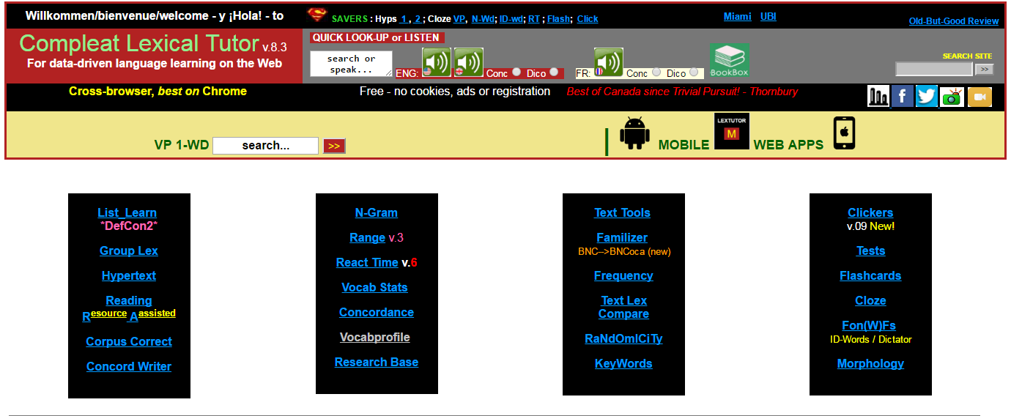
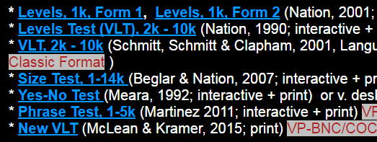
Notes:
VLT available at lextutor and also at Norbert’s website.

Slide 15
Textual enhancement
Finding:
Highlighting words in a text can have a positive effect on acquisition.
Examples:
Boers et al, 2016; Szudarski & Carter, 2016.
Action:
underline, italicise, and/or embolden target words
awl highlighter

Slide 16
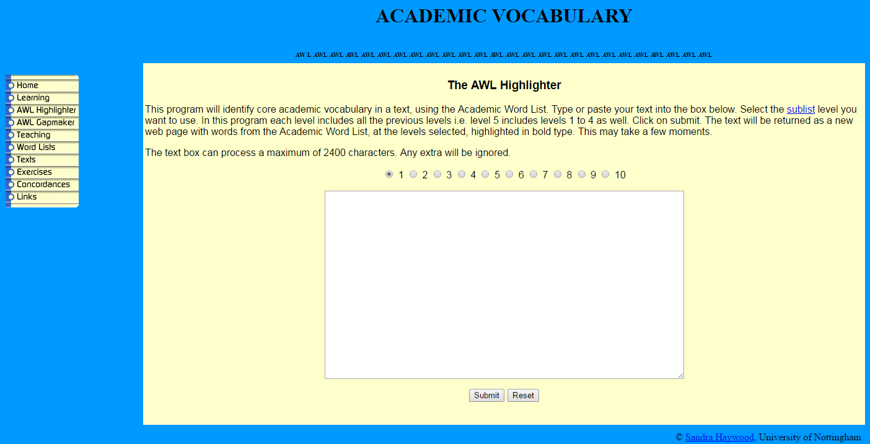
Notes:
Select the level of sublist – 10 means all words on the AWL will be included.

Slide 17
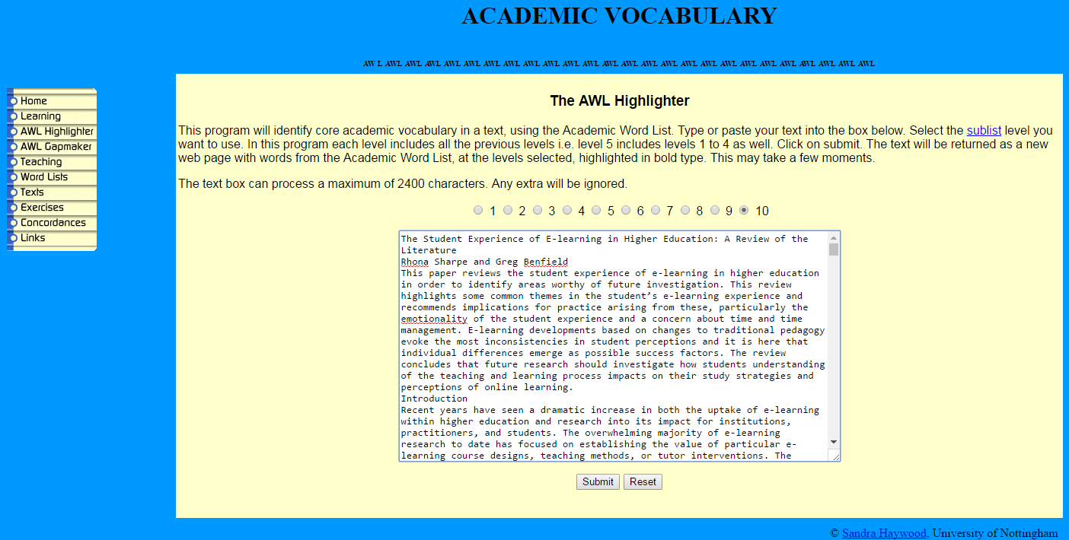
Notes:
Select the level of sublist – 10 means all words on the AWL will be included.

Slide 18
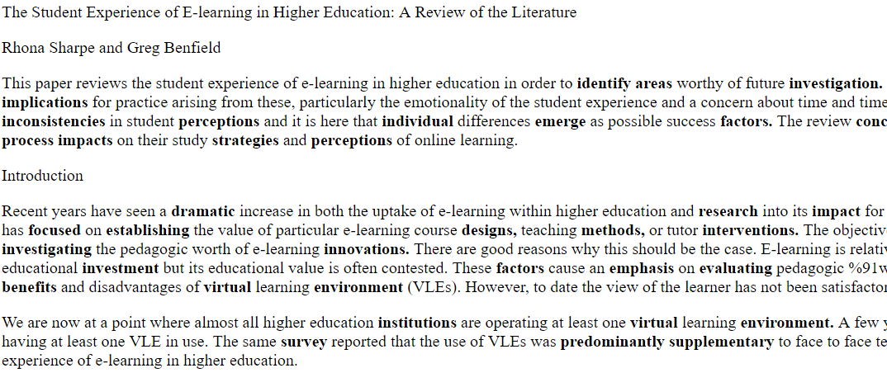

Slide 20
Resources for planning a class
Compleat Lexical Tutor
AWL highlighter
Resources to use in class
Resources for students to use independently

Slide 21
Resources for planning a class
Compleat Lexical Tutor
AWL highlighter
Resources to use in class
Resources for students to use independently

Slide 22
Word-Part Knowledge
Finding:
Students need a very large vocabulary to read ungraded texts.
Examples:
Nation, 2006; Adolphs & Schmitt, 2003.
Action:
Encourage vocabulary discovery strategies
www.affixes.org

Slide 23
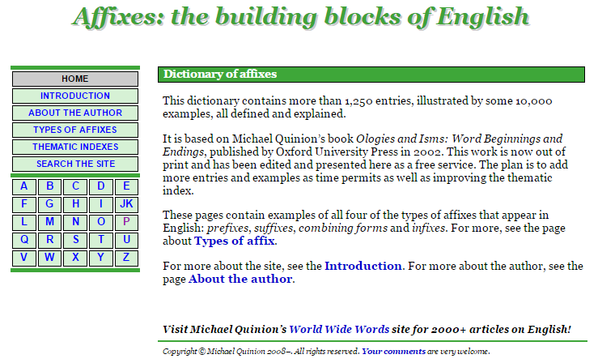

Slide 24
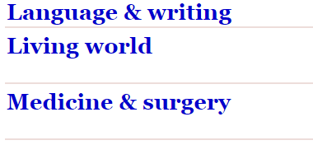

Slide 25
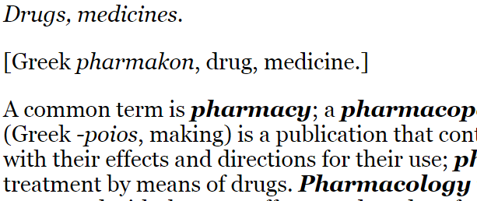

Slide 26
Use corpora for deeper aspects of word knowledge
Finding:
Context can foster the development of collocation, colligation, and formulaic sequences.
Example(s):
Rezaee et al., 2015.
Action:
Use corpora to explore lexical patterning
http://flax.nzdl.org/greenstone3/flax

Slide 27
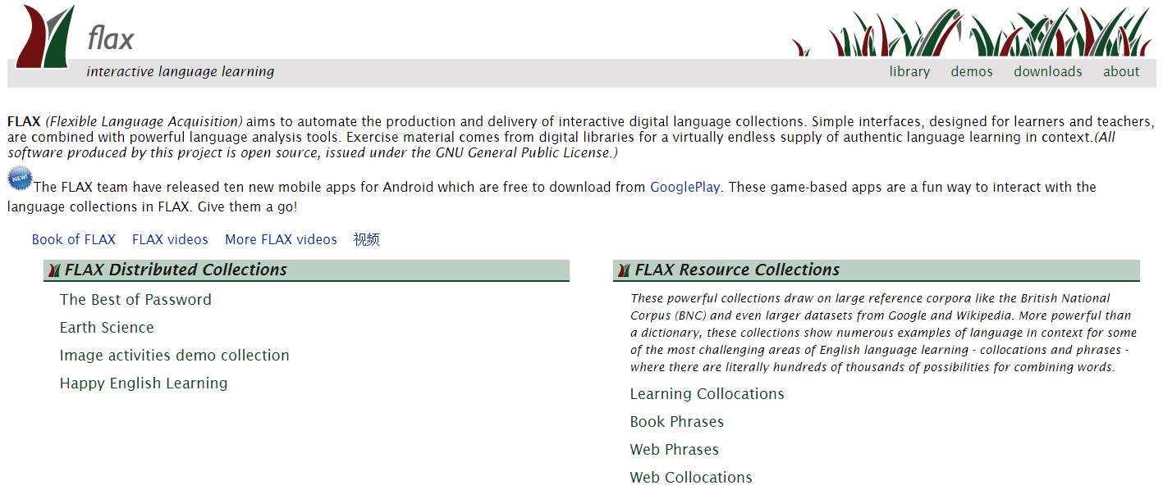

Slide 29
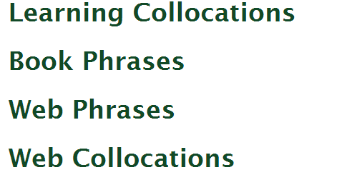

Slide 32
Resources for planning a class
Compleat Lexical Tutor
AWL highlighter
Resources to use in class
affixes.org
FLAX
Resources for students to use independently

Slide 33
Resources for planning a class
Compleat Lexical Tutor
AWL highlighter
Resources to use in class
affixes.org
FLAX
Resources for students to use independently

Slide 34
Retrieval
Finding:
The extent of recycling and retrieval influences the learning and retention of vocabulary.
Examples:
Nakata, 2015; Peters, 2014
Action:
Encourage students to use flashcards
Anki (etc.)

Slide 35
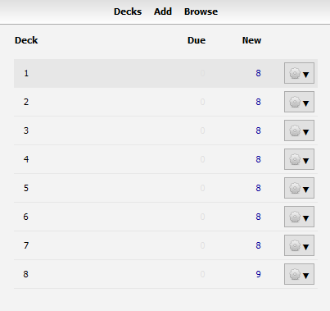

Slide 36
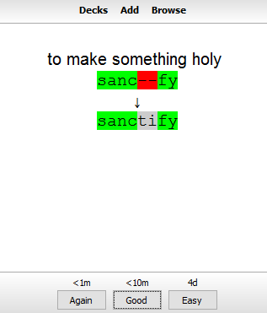

Slide 37
Meaning-Focused Input
Research finding:
A great deal of comprehensible input is needed.
Example(s):
Waring and Takaki, 2003.
Action:
Encourage students to read appropriately graded texts
www.er-central.com

Slide 38
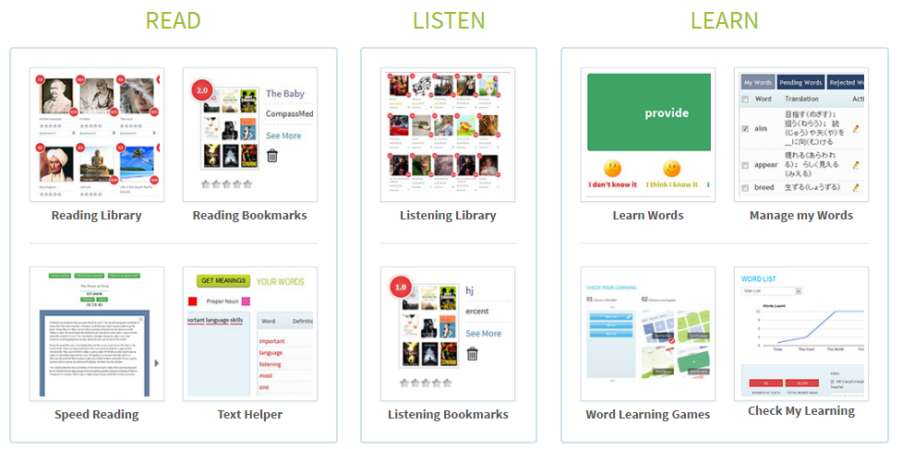

Slide 39
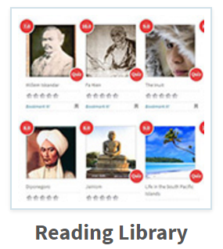

Slide 40
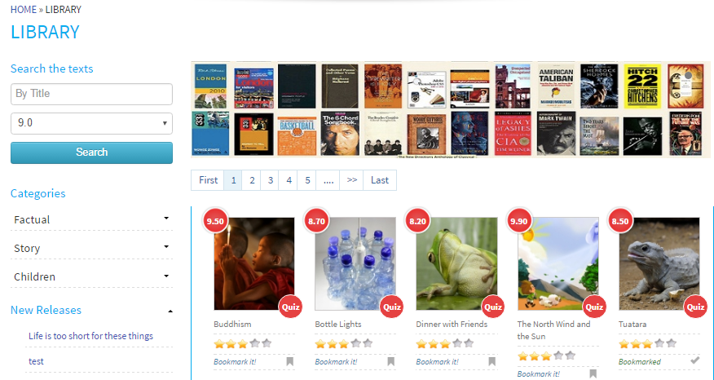
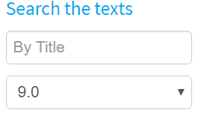

Slide 44
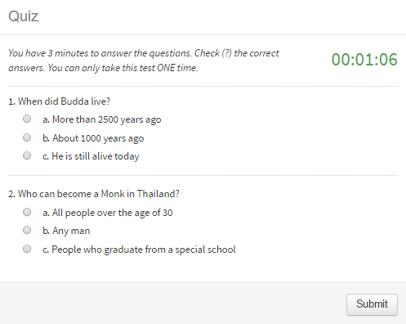

Slide 45
Resources for planning a class
Compleat Lexical Tutor
AWL highlighter
Resources to use in class
affixes.org
FLAX
Resources for students to use independently
Anki
Extensive Reading Central

Slide 46
Adolphs, S., & Schmitt, N. (2003). Lexical Coverage of Spoken Discourse. Applied Linguistics, 24(4), 425-438.
Boers, F., Demecheleer, M., He, L., Deconinck, J., Stengers, H., & Eyckmansc, J. (2016). Typographic enhancement of multiword units in second language text. International Journal of Applied Linguistics. doi:10.1111/ijal.12141 .
Brutten, S. R. (1981). An analysis of student and teacher indications of vocabulary difficulty. RELC Journal, 12(1), 66-71.
Nakata, T. (2015). Effects of Expanding and Equal Spacing on Second Language Vocabulary Learning: Does Gradually Increasing Spacing Increase Vocabulary Learning? Studies in Second Language Acquisition, 37(677 – 711). doi:10.1017/S0272263114000825
Nation, I. S. P. (2006). How Large a Vocabulary Is Needed For Reading and Listening. The Canadian Modern Language Review, 63(1), 59-82.

Slide 47
Peters, E. (2014). The effects of repetition and time of post-test administration on EFL learners' form recall of single words and collocations. Language Teaching Research, 18(1), 75-94.
Rezaee, A. A., Marefat, H., & Saeedakhtar, A. (2015). Symmetrical and asymmetrical scaffolding of L2 collocations in the context of concordancing. CALL, 28(6), 532-549. doi:10.1080/09588221.2014.889712
Riley, P. A., & Whistler, B. (1999). Teacher Perceptions of Student Vocabulary. Paper presented at the JALT 99, Tokyo.
Szudarski, P., & Carter, R. (2016). The role of input flood and input enhancement in EFL learners' acquisition of collocations . International Journal of Applied Linguistics, 26, 245 – 265. doi:10.1111/ijal.12092 .
Waring, R., & Takaki, M. (2003). At what rate do learners learn and retain new vocabulary from reading a graded reader? Reading in a Foreign Language, 15(2), 130-163.

Slide 49
samuel.barclay@ntu.ac.uk

