Slide 1

Assessing Vocabulary
TESOL Convention 2017 – Seattle
Diane Schmitt
Nottingham Trent University

Slide 2

How do we choose
which vocabulary to assess?
It depends on the purpose of the test.

Slide 3

Vocabulary Assessment
diagnostic
placement
proficiency
achievement
motivation
washback

Slide 4
Vocabulary Assessment
Proficiency
  Size estimates
Achievement (Classroom Assessment)
  Use

Slide 5

How much vocabulary do learners need?
250 words or fewer – read graded readers
2-3,000 words - understand defining vocabulary of learner dictionaries
2-3,000 words – participate in daily conversation
3,000 – use TV and movies for teaching/learning
5,000 words – read authentic texts w/assistance
6-7,000 words – understand a wide range of oral discourse without assistance
8-9,000 words – understand a wide range of written discourse
(Schmitt & Schmitt, 2014)

Slide 6
Assessment of vocabulary size
  The Vocabulary Levels Test (profile)
    2000, 3000, 5000, 10000 + AWL
  Lexica by Diglossia
    Top 5000 frequent words
  The Vocabulary Size Test (total score)
    14,000 or 20,000
  Computer Adaptive Test of Size and Strength
Do not assume that all tests have validation studies to
support their use. (Gyllstad, Vilkaite & Schmitt, 2015)

Slide 7
Assessment of vocabulary size
Vocabulary
Size
Vocabulary
Profile

Slide 8
How much vocabulary do learners need?
250 words or fewer – read graded readers
2-3,000 words - understand defining vocabulary of learner dictionaries
2-3,000 words – participate in daily conversation
3,000 – use TV and movies for teaching/learning
5,000 words – read authentic texts w/assistance
6-7,000 words – understand a wide range of oral discourse without assistance
8-9,000 words – understand a wide range of written discourse
NOT total vocabulary size,
but mastery of each of these frequency bands

Slide 9
Concerns of Size Test Developers
Interpretation – what do the scores mean, how should they be used?
  Mode – receptive or productive?
  Source of words – which list/corpus?
  Counting unit – word, lemma, word family?
  Item format – aim to limit impact of guessing/recall or recognition?

Slide 10
Concerns of size test developers
Interpretation
Mode receptive or productive
  Laufer et al (2004) and Laufer & Goldstein (2004), Gonzales-Fernandez & Schmitt (under review)
  Decontextualized knowledge
  Sight words - Ehri (1995)

Slide 11
Concerns of Size Test Developers
Interpretation
Word source for proficiency, large corpora give the widest coverage of vocabulary for general use (e.g. Brezina and Gablasova, 2013)

Slide 12
Concerns of Size Test Developers
Interpretation
Counting unit research is moving from word families to lemmas
  (Gardner, 2007; Kremmel, 2016)
possess (possessed, possessing, possesses, possession, possessor, possessive, repossess, repossession)

Slide 13
Concerns of size test developers
Interpretation
Item format

Slide 14

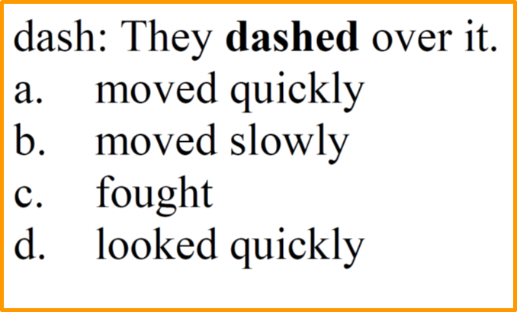
Concerns of size test developers
Interpretation
Item format Kremmel & Schmitt (2016)
Scores must be interpreted as estimates as all formats over- and under-estimate knowledge

Slide 15
Concerns of size test developers
Interpretation
Item format Kremmel & Schmitt (2016)
  Form
  Meaning
  Grammatical knowledge – derivations (over 1/3)
  Collocations (almost 1/2)
Form – Meaning Link

Slide 16
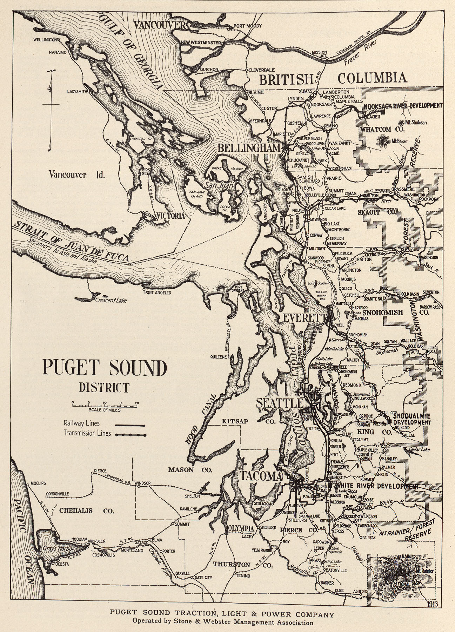

Uncharted Waters
Researching
Achievement Testing

Slide 17
How do we choose
which vocabulary to assess?
It depends on the purpose of the test.

Slide 18
The purpose of any assessment, in turn, depends on the aims of your course or programme.

Slide 19

Syllabus or programme aims
Size and/or depth
or
vocabulary fluency or accuracy in their own right or
the role of vocabulary in developing reading, writing, speaking and listening skills
or
  developing summary and paraphrasing skills for academic writing
  or
  Vocabulary strategies (e.g. dictionary use)
Notes:
ACTIVITY TIME
What specific vocabulary goals are needed to successfully achieve each of these?
Fluent reading – rapid word recognition skills, ability to use contextual clues
Interactive listening and speaking– understanding pronunciation in connected speech, rapid lexical access (TOEFL timed speaking tasks)
Paraphrasing and summarizing “in one’s own words” requires a large vocabulary, in also requires learners to recognise nuanced differences between meanings of synonyms, grammatical behaviour, associations/connotations
Much of the research on negotiation of meaning in SLA studies show that a large proportion of negotiation or language related episodes revolve around lexis rather than grammar

Slide 20
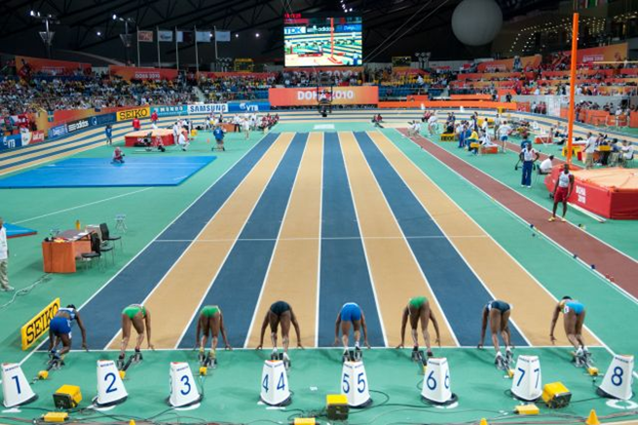
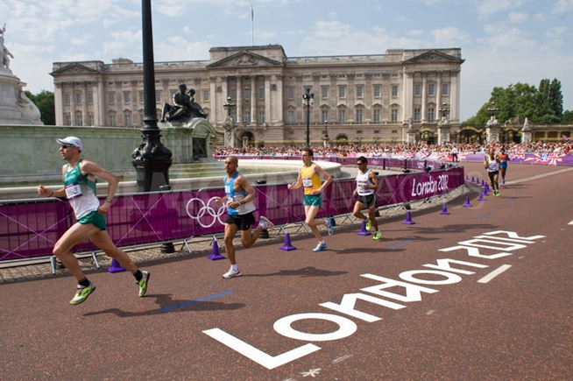
Size
  Does your textbook or curriculum have a list of vocabulary?
  Do you follow a topic or theme-based syllabus?
  Are you focusing on high frequency or mid-frequency vocabulary?
Short-run vocabulary
Long-run vocabulary
Gardner, 2013
Notes:
ACTIVITY TIME
What specific vocabulary goals are needed to successfully achieve each of these?
Fluent reading – rapid word recognition skills, ability to use contextual clues
Interactive listening and speaking– understanding pronunciation in connected speech, rapid lexical access (TOEFL timed speaking tasks)
Paraphrasing and summarizing “in one’s own words” requires a large vocabulary, in also requires learners to recognise nuanced differences between meanings of synonyms, grammatical behaviour, associations/connotations
Much of the research on negotiation of meaning in SLA studies show that a large proportion of negotiation or language related episodes revolve around lexis rather than grammar

Slide 21


Size
  Does your textbook or curriculum have a list of vocabulary?
  Do you follow a topic or theme-based syllabus?
  Are you focusing on high frequency, mid-frequency or specialist vocabulary?
Notes:
ACTIVITY TIME
What specific vocabulary goals are needed to successfully achieve each of these?
Fluent reading – rapid word recognition skills, ability to use contextual clues
Interactive listening and speaking– understanding pronunciation in connected speech, rapid lexical access (TOEFL timed speaking tasks)
Paraphrasing and summarizing “in one’s own words” requires a large vocabulary, in also requires learners to recognise nuanced differences between meanings of synonyms, grammatical behaviour, associations/connotations
Much of the research on negotiation of meaning in SLA studies show that a large proportion of negotiation or language related episodes revolve around lexis rather than grammar

Slide 22
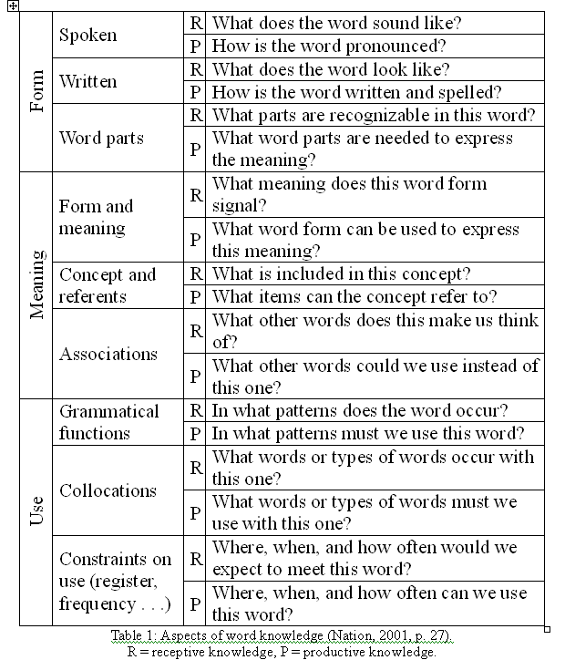
Depth
Word knowledge
Form, meaning and use
Incremental learning: rewarding partial knowledge
Receptive vs. productive
Lexical access
Brown (2010) found that textbooks gave little attention to word knowledge beyond the form-meaning link

Slide 23
Ways to measure different aspects of knowledge of a word
Underline the word that is not likely to
be used together with accept
(receptive knowledge of collocation):
1. offer
2. holidays
3. invitation
4. responsibility
Underline the correct spelling
(receptive knowledge of written form):
1. acept
2. acsept
3. accept
4. axept
Underline a word with an unrelated
meaning
(receptive knowledge of association):
1. decline
2. receive
3. refuse
4. reduce
Underline the correct sentence
(receptive knowledge of grammatical
functions):
1. She accepts.
2. It is accept.
3. It is an accept.

Slide 24
Ways to measure different aspects of knowledge for a word
Underline the incorrect derivation
(receptive knowledge of word parts):
1. acception
2. accepting
3. acceptance
4. acceptable

Slide 25
Partial knowledge
(L2 English dog = L1 German hund)
Meaning recognition:
dog a. katze b. hund c. maus d. vogel
Form recognition:
hund a. cat b. dog c. mouse d. bird
Meaning recall: dog h_____
Form recall: d_____ hund
(CATSS Test: Laufer and Goldstein, 2004)
Notes:
ACTIVITY TIME
What specific vocabulary goals are needed to successfully achieve each of these?
Fluent reading – rapid word recognition skills, ability to use contextual clues
Interactive listening and speaking– understanding pronunciation in connected speech, rapid lexical access (TOEFL timed speaking tasks)
Paraphrasing and summarizing “in one’s own words” requires a large vocabulary, in also requires learners to recognise nuanced differences between meanings of synonyms, grammatical behaviour, associations/connotations
Much of the research on negotiation of meaning in SLA studies show that a large proportion of negotiation or language related episodes revolve around lexis rather than grammar

Slide 26
Partial knowledge
Gonzales-Fernandez & Schmitt (under review)
Form-meaning link
Polysemy
Collocation
Derivatives
Form-meaning link
Polysemy
Collocation
Derivatives
Productive
Receptive
Notes:
ACTIVITY TIME
What specific vocabulary goals are needed to successfully achieve each of these?
Fluent reading – rapid word recognition skills, ability to use contextual clues
Interactive listening and speaking– understanding pronunciation in connected speech, rapid lexical access (TOEFL timed speaking tasks)
Paraphrasing and summarizing “in one’s own words” requires a large vocabulary, in also requires learners to recognise nuanced differences between meanings of synonyms, grammatical behaviour, associations/connotations
Much of the research on negotiation of meaning in SLA studies show that a large proportion of negotiation or language related episodes revolve around lexis rather than grammar

Slide 27
Vocabulary in the skills: writing
Beware of overlap across categories

Slide 28

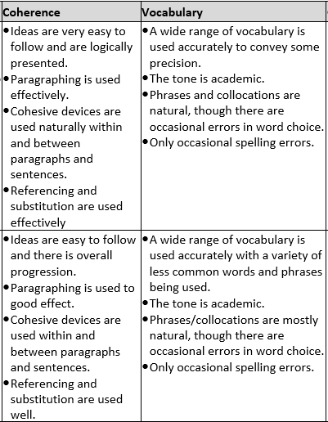

Beware of
potential
contradictions
across
categories

Slide 29
Skills and strategies
Learners can benefit from training in:
  guessing from context (Walters, 2004, 2006)
  dictionary use
  using word cards
  using word parts
Guessing from context test
Word parts test
Yosuke Sasao Toyohashi University of Technology Japan
Downloadable from: http://ysasaojp.info/testen.html

Slide 30
When to test?
When does learning become acquisition?
  In textbook vocabulary reviews and tests either come immediately at the end of a chapter or they come after a set or unit of chapters have been completed.
Research requires a post-test and a delayed post test to confirm retention.
Notes:
ACTIVITY TIME
What specific vocabulary goals are needed to successfully achieve each of these?
Fluent reading – rapid word recognition skills, ability to use contextual clues
Interactive listening and speaking– understanding pronunciation in connected speech, rapid lexical access (TOEFL timed speaking tasks)
Paraphrasing and summarizing “in one’s own words” requires a large vocabulary, in also requires learners to recognise nuanced differences between meanings of synonyms, grammatical behaviour, associations/connotations
Much of the research on negotiation of meaning in SLA studies show that a large proportion of negotiation or language related episodes revolve around lexis rather than grammar

Slide 31
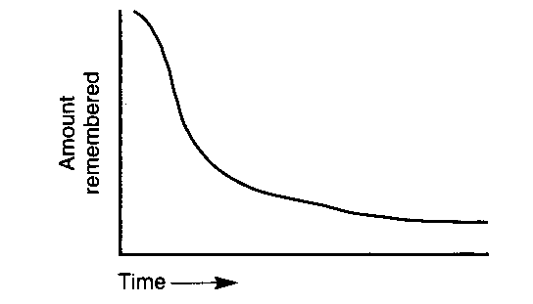
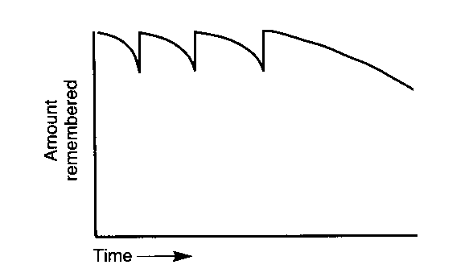
When to test?
The forgetting curve
Expanding rehearsal
Rott et al (2002) found that 5 weeks between first encounter and test was too long.
Notes:
ACTIVITY TIME
What specific vocabulary goals are needed to successfully achieve each of these?
Fluent reading – rapid word recognition skills, ability to use contextual clues
Interactive listening and speaking– understanding pronunciation in connected speech, rapid lexical access (TOEFL timed speaking tasks)
Paraphrasing and summarizing “in one’s own words” requires a large vocabulary, in also requires learners to recognise nuanced differences between meanings of synonyms, grammatical behaviour, associations/connotations
Much of the research on negotiation of meaning in SLA studies show that a large proportion of negotiation or language related episodes revolve around lexis rather than grammar

Slide 32
The current state of vocabulary assessment
Lots of questions
Not so many ready-made answers
Lots of need for innovative thinking

