Slide 1
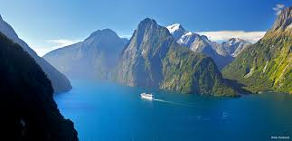
Specialised vocabulary
Averil Coxhead
Victoria University of Wellington
Aotearoa/New Zealand
Notes:
25-30 mins – TESOL 22 March, 9.30-12.15 – Research into practice symposium

Slide 2
Today’s talk: Specialised vocabulary
Identifying
What is this vocabulary?
Why is it important?
Listing
When we use lists made by others, what do teachers need to think about?
Teaching
What do teachers need to take into consideration?

Slide 3
Specialised vocabulary: Let’s start with you
How did you learn the professional vocabulary of your field?
If you teach ESP, what approach do you take to professional vocabulary in the field/s you teach?

Slide 4
Identifying specialised vocabulary
What is this vocabulary?
Why is it important?
How can we figure out what it is?

Slide 5
Specialised vocabulary…
Has some particular characteristics
Narrow range of use
Frequency
Size – 1,000-5,000 words? (Nation, 2008: 10)
Is likely to be a substantial amount of a text
Using a scale, Chung & Nation (2004) found
30 % of an anatomy text
20% of an applied linguistics text…
Can be difficult to define
roof; foundation; stud; dwangs; H1; H1.2; aggregate; clinical; Parkinson/Parkinson’s;
fault; photosynthesis; cambelt; putty; volt
Notes:
People outside that academic or professional sphere might have some knowledge of this vocabulary
But people inside these areas of language use would be expected to be able to understand and use this language fluently

Slide 6
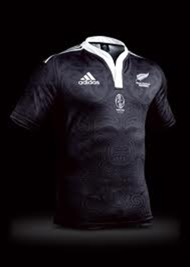
The important of subject knowledge
Students’ knowledge of a discipline is closely tied to the specialised language of that discipline Woodward-Kron (2008, p. 246)
Try talking about language teaching without mentioning vocabulary, grammar, or culture
Or talking about New Zealand (perhaps) without mentioning the All Blacks…
What do your learners already know about the subject/content?

Slide 7
Here are some examples of lists of specialised vocabulary. What fields are they from?
List one | List two | List three | List four
caulk actuate bylaw haemodialysis thermistor hotwater underfloor airtight desludged hydrostatics milliampere | lump measure porous resources straw stress benefit cladding crack duct insulation lintel | bar arrest constitute deny court document permit warrant withdraw proceed fingerprint excuse | drug cell muscle stress affect bacteria cope quit facility federal advocate outcome

Slide 8
List one | List Two | List Three | List Four
caulk actuate bylaw haemodialysis thermistor hotwater underfloor airtight desludged hydrostatics milliampere | lump measure porous resources straw stress benefit cladding crack duct insulation lintel | bar arrest constitute deny court document permit warrant withdraw proceed fingerprint excuse | drug cell muscle stress affect bacteria cope quit facility federal advocate outcome
Plumbing (Coxhead, under review) | Architecture (Peters & Fernández, 2013) | Movies, TV programmes and the Law (Csomay & Petrović, 2012) | Middle School Health Vocabulary List (Greene & Coxhead, 2015)

Slide 9
Approaches to specialised vocabulary
Use a technical dictionary
Employ a scale
Ask an expert
Develop a specialised corpus
Others?

Slide 10
Lists of specialised vocabulary
When we use specialised word lists made by others, what do we need to think about?

Slide 11
How was a list made? Using a corpus?
What was the study?
Purpose
Outcome
Assumptions
Who were the learners?
The needs of the students
The language level of the students
What was the corpus like?
Size
Representativeness
The kinds of texts
Written or spoken
Professional or student writers
Organisation
Unit of counting
Lemmas/word families/types/flemmas/others?
Anything else?

Slide 12
Starting points for lists?
Head straight into specialised vocabulary based on learner needs (e.g. Ward, 2009)?
Look for ratios of general and specialised vocabulary (Gardner & Davies, 2014)?
Build on general vocabulary knowledge first (e.g. Coxhead, 2000; Coxhead & Hirsh, 2009)?
Notes:
Ward: An English word list of basic engineering to support lower proficiency undergraduates
Ward’s final list contains 299 word types and covers 16.4% of a corpus of engineering textbooks (page 179).
Of these 299 word types
188 are also in the GSL 1000 list
28 are in West’s (1953) GSL 2000
78 are in the AWL (page 177).
The top ten words from Ward’s list are system, shown, equation, example, value, design, used, section, flow, and given (page 181).

Slide 13
Single words or multi-word units?
Apart from single words, what else might be in a corpus of academic writing, for example?
frequent repetition of two-word collocations
frames with slots/academic formulas/phrases
possibly an idiom or two
some commonly used metaphoric language
Notes:
‘lexical bundles’ are the ‘… basic building blocks of discourse’ (Biber, et al., 2004:371)
phrases facilitated real-time fluency in speaking (Skehan, 1998)
Phrases tend to be overused by non-native writers, that non-native speakers use less of a variety of phrases than native speakers, and that non-native speakers exhibit more repetition of higher frequency items (De Cock, 2005)
Formulaic sequences for speakers to process and interact, and express their identity with a group (Wray, 2002: 203)
Clear benefits for idiomatic formulaic sequences in processing while reading for both native and non-native speakers (Schmitt, 2005)

Slide 14
A word of caution about multi-word units
on the basis of
308 times in the 3.6 million words
106 times per million words
53 times per 500,000 words
twice per 15,625 words (Coxhead & Byrd, 2010)

Slide 15
There’s frequency, and then there is….
For example… Clyne's research provides valuable information on the distribution of a large number of these languages in Australia (Clyne, 1985, 1991, Clyne and Kipp,1996). On the basis of his analyses, Clyne also identifies a number of "unequivocally important" factors as relevant in accounting for different rates of language shift in different communities….
Notes:
What else might be tricky in this text?

Slide 16
Some examples of specialised lists
Academic single words
Gardner & Davies (2014) Academic vocabulary list
Coxhead (2000) Academic word list
Academic Multi-word units
Simpson-Vlach & Ellis (2010) Academic formulas list
Ackermann & Chen (2013) Academic Collocation List (ACL)
Liu (2012) Frequently-used multi-word constructions in academic written English
Engineering
Watson-Todd (2017) An opaque engineering word list
Ward (2009) A basic engineering English word list
Medical
Lei & Liu (2016). A new medical academic word list
Science
Coxhead, A. & Hirsh, D. (2007). A pilot science word list for EAP
Trades
Coxhead, Demecheleer & McLaughlin (2016). The technical vocabulary of Carpentry

Slide 17
Thinking about teaching
What do teachers need to take into consideration about specialised vocabulary?

Slide 18
What are the jobs of the vocabulary teacher?
Nation’s (2013) framework
Planning
Strategy training
Testing
Teaching
In that very specific order

Slide 19
Four Strands and Involvement Load?
Nation’s Four Strands (2007)
Meaning-focused input
Meaning-focused output
Language-focused learning
Fluency
Laufer & Hustijn’s Involvement Load Hypothesis
Need
Search
Evaluation

Slide 20
Lexical needs of ESP students in a professional field (Peters & Fernández, 2013)
Spanish architecture study
110 participants
Building engineering students
What lexical items would they need help with?
What resources would they use to help them with the unknown vocabulary?

Slide 21
How would you categorise these building terms?
Benefit
Cladding
Crack
Duct
Insulation
Lintel
Lump
Measure
Porous
Resources
Straw
Stress

Slide 22
What did the learners say?
They tended to look up technical words in dictionaries (such as gutter, façade, and rubble)
But – general and scientific vocabulary, such as framework, sustainability, and consumption also caused problems – more so than the technical words.
Bilingual and monolingual dictionaries were used, but learners needed training to become independent users.
How do these findings fit with your own professional vocabulary knowledge?

Slide 23
Movies, TV programmes and the Law (Csomay & Petrović, 2012)
Uses the repetition of technical vocabulary in movies/TV (Webb, 2010) as a factor for selecting lexical items
Movie and TV corpus – 128, 897 running words
Will there be any difference between movies and TV in terms of occurrence of technical vocabulary?
What to do with ‘brief’ and ‘party’ as legal terms?
Checked legal dictionaries
Used Congram for context

Slide 24
Opportunities for incidental learning? (Csomay & Petrović, 2012: 312)
Bands | The Rainmaker
1 (5-7 encounters) | We’re gonna ARGUE Great Benefit’s motion to dismiss I’m prepared to ARGUE the motion Let him ARGUE the case
2 (8-9 encounters) | I come from Memphis to DEPOSE four people I’m going to DEPOSE Mr Lefkin, then I’m going to go The DEPOSTION is set for next Thursday afternoon I’m going to take DEPOSITIONS from all the executives
3 (10+ encounters) | You should fight for your CLIENT She no longer works for our CLIENT Your CLIENT has a million dollars

Slide 25
More examples of headwords
Rank these items in terms of their connection to Law
And then rank according to teachability
Technical Law terms from (Csomay & Petrović, 2012: 314-5)
Bar, arrest, constitute, deny, court, document, permit, warrant, withdraw, proceed, firearm, fingerprint, exam, and excuse

Slide 26
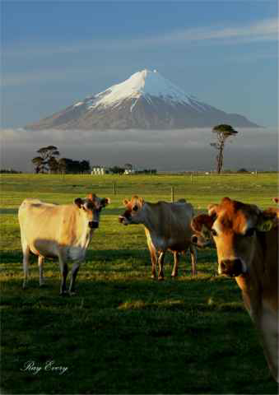
What questions do you have?

