Slide 1
Vocabulary Teaching
Pedagogy
Dee Gardner
Brigham Young University
TESOL
Seattle 2017
Dee_Gardner@byu.edu

Slide 2
Difficulty with Vocabulary Learning and Teaching
Over TWO MILLION Lexemes
and Growing

Slide 3
Most important question an ELL teacher can ask regarding vocabulary instruction--
What English is Needed?
Time is of the essence
Resources are limited

Slide 4
Vocabulary Centered Curriculum
What English is Needed?
Academic? Business? Vocational?
What Texts and Tasks?
Textbooks? Contracts? Manuals?
Listening
Speaking
Vocabulary
What Vocabulary?
in texts and tasks?
in learners’ minds?
needing instruction?
What Curriculum?
Integrated Skills
Theme-Based
Reading
Writing
What Strategies?
Morphological Awareness
Dictionaries, etc.
Using Context

Slide 5
Academic English
Case Study

Slide 6
Goldenberg (2008) – based on 2007 National Assessment of Educational Progress Report (NAEP)
“…fourth-grade ELLs scored 36 points below non-ELLs in reading and 25 points below non-ELLs in math. The gaps among eighth-graders were even larger—42 points in reading and 37 points in math.”
“Whatever the explanation for these achievement gaps, they bode ill for English learners’ future educational and vocational options.”
“They also bode ill for society as a whole, since the costs of large-scale underachievement are very high” (p. 11)

Slide 7
Why academic vocabulary?
Academic vocabulary knowledge is recognized as an indispensable component of academic reading abilities (Biemiller, 1999; Corson, 1997), which, in turn, have been directly linked to academic success, economic opportunity, and societal well-being (Goldenberg, 2008; Ippolito, Steele, & Samson, 2008; Jacobs, 2008)

Slide 8
Academic Vocabulary Knowledge
Academic Reading Skills
Academic Success
Economic Opportunity
Societal Well-Being

Slide 9
NECAP 2015 Results – Science Proficiency
Student Group | Grade 4
 | % Prof. 2015
State Average | 40
Males | 37.2
Females | 43
IEP | 8.5
Non-IEP | 44.9
LEP | 6.1
LEP Monitored | 27.6
Non-LEP | 43.7
Low Income | 23.1
Non-Low Income | 57.8
American Indian | 20.3
Asian | 38.6
Black | 18.5
Hispanic | 19.9
White | 52.1
Repurposed from NECAP Public Data (New England Common Assessment Program)

Slide 10
USBE SAGE PROFICIENCY RESULTS (2015-2016)
All Students in Utah Grades 3-11 Tested
 | Science | Math
All Students | 49% | 47%
Ethnicity
Asian | 51% | 54%
African American/ Black | 21% | 20%
White | 56% | 53%
Hispanic/Latino | 24% | 23%
American Indian | 20% | 19%
Pacific Islander | 23% | 27%
ELL | 4% | 9%
Eco. Disadv | 32% | 31%
http://www.schools.utah.gov/data/Reports/Assessment/NewsReleaseSAGE2016.aspx

Slide 11
Chall – on “Preventing the Fourth-Grade Slump”
“Students seem to need three kinds of strengths in order to progress to Stage 3 [Reading to Learn]: sufficient knowledge of the meanings of more academic and abstract words, sufficient reasoning ability to understand the more difficult texts, and facility with reading skills—word recognition, and decoding, and fluency” (emphases added)

Slide 12
The number one problem for ELLs taking the WIDA, CRT, and SAGE tests is VOCABULARY, in terms of both understanding the instructions and actually comprehending the content of the tests.
From Personal Communication with Delia Allan (ELL Liaison and Test Proctor for Nebo School District in Utah)

Slide 13
From WIDA Standards Framework
“Making explicit the forms and conventions associated with academic registers contributes to students’ language proficiency . . . and content area performance”[emphasis added].

Slide 14
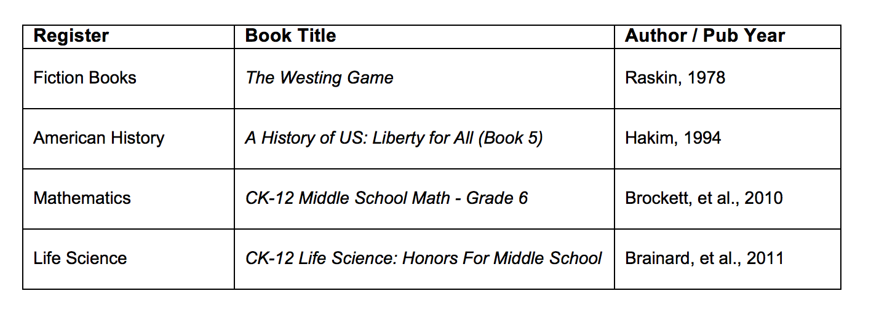
Register (Discipline) Case Study
Adapted from Gardner (2013, pp. 72)

Slide 15
Examples of Specialized (Technical) Vocabulary in Four Different Disciplines
FICTION | # | AM HISTORY | # | MATHEMATICS | # | LIFE SCIENCE | #
WESTING WEXLER SYDELLE THEO OTIS PULASKI BAUMBACH HEIRS DOUG DENTON THEODORAKIS MCSOUTHERS DOORMAN PLUM BARNEY HEIR NORTHRUP MADAME SHIN WINDKLOPPEL INTERN DRESSMAKER CRUTCH WINDSOR SIKES DUMB BABA BRAID ALICE | 361 156 135 133 118 108 99 90 88 55 52 51 47 42 36 35 35 33 32 31 28 24 23 23 21 17 16 16 15 | MISSOURI WAGONS OREGON FE JACKSON MORMONS KANSAS THOREAU OHIO WHALING ELLEN MANJIRO PIONEERS VIRGINIA LINCOLN ABOLITIONISTS BOWDITCH SALEM EMERSON POLK FORT NATHANIEL TELEGRAPH JEFFERSON MELVILLE OBERLIN PHILADELPHIA PONY ANDREW | 61 41 38 35 34 32 29 29 28 27 26 25 25 24 23 22 22 22 21 20 19 19 19 18 18 18 18 18 17 | DECIMAL DECIMALS TRIANGLE INTEGERS DENOMINATOR TRAVIS RECTANGLE SUBTRACT SUBTRACTION ZERO GRID TANIA CONGRUENT NUMERICAL NUMERATOR UNDERLINE PARALLELOGRAM MEDIAN DENOMINATORS ISAAC PERCENTS MARC INTEGER REAL-WORLD HOWSTUFFWORKS HUNDREDTHS PERIMETER CYLINDER LARRY | 468 330 217 189 176 146 145 107 106 100 98 97 95 88 87 87 84 81 77 77 76 75 74 74 68 66 65 59 56 | ORGANISMS JPG WIKIMEDIA BACTERIA DNA FUNGI ORGANISM TRAITS NUTRIENTS GNU-FDL MOLECULES CHROMOSOMES REPRODUCTION MAMMALS REPRODUCTIVE MEMBRANE DIGESTIVE PATHOGENS DIOXIDE CC-BY-SA PROTISTS RESPIRATORY PREY ECOSYSTEM IMMUNE CARDIOVASCULAR CHROMOSOME DARWIN PHOTOSYNTHESIS | 393 365 340 316 278 188 157 157 156 152 137 131 125 121 120 119 118 114 113 112 105 104 95 94 89 88 86 85 85
Adapted from Gardner (2013, pp. 72-73)

Slide 16
Examples of General (Core) Vocabulary in Four Different Disciplines
FICTION | # | AM HISTORY | # | MATHEMATICS |  | # | LIFE SCIENCE | #
APARTMENT TOWERS MURDERER BOMB STARED BOMBER ELEVATOR HURRIED LEANED STUPID NODDED STARING WINDY REMARKED SHOUTING VICTIM ATTORNEY DRIVEWAY PAUSED BET CORPORATION CLEARED BOMBS ENGAGEMENT PARTNERS DECORATOR MT | 56 53 49 25 25 24 21 13 13 12 12 11 10 10 10 10 10 9 9 8 8 7 7 7 7 7 7 | SLAVE SLAVERY INDIANS SLAVES SPANISH SAILORS COMPROMISE SETTLERS INDEPENDENCE MEXICANS BLACKS CLAY FOUGHT TERRITORIES DECLARATION ARTISTS CHURCH RAILROADS MINERS CREW TRADERS TRAINS CIVIL SOUTHERNERS CONSTITUTION DEMOCRACY SAIL | 99 99 69 55 32 26 24 23 23 22 21 20 19 19 17 16 16 16 16 15 14 12 12 12 12 12 12 | FRACTIONS MULTIPLICATION SIMPLIFY OPERATIONS ESTIMATION ROUNDING SQ VIDEOS GRAPHS REWRITE PM DISCOUNT ASKS MULTIPLES COORDINATES TENTHS SLICES THOUSANDTHS SUBSTITUTE CORRESPONDING SCORE WHOLES ESTIMATING PINTS SIMPLIFYING DISTRIBUTIVE SUPPLEMENTARY | 408 172 135 110 106 92 71 68 60 58 53 50 46 44 42 40 36 35 34 32 30 30 30 27 26 25 24 |  | ORGANISMS COMMONS DOMAIN ORGANS OXYGEN EVOLUTION HUMANS FOODS CYCLE GENETIC PROTEIN PROTEINS BONE GENE GOV STRUCTURES ORGAN SOURCES SELECTION GENES SUMMARY PRESSURE OBJECTIVES SUPPLEMENTAL CHEMICALS THEORY INTERNAL | 393 796 342 266 207 192 167 149 134 126 124 124 124 116 108 104 102 99 92 90 90 87 85 85 83 82 81
Adapted from Gardner (2013, pp. 76)

Slide 17
Examples of Phrases in Four Different Disciplines
FICTION | AM HISTORY | MATHEMATICS | LIFE SCIENCE
2-Word PHrases otis amber 97 sam westing 92 flora baumbach 72 sydelle pulaski 71 judge ford 66 mr hoo 65 sunset towers 52 westing house 48 denton deere 45 grace wexler 35 Barney northrup 33 coffee shop 25 jake wexler 25 westing paper 25 mr mcsouthers 24 all right 23 doug hoo 23 thank you 23 delivery boy 22 grace windsor 22 mrs wexler 22 windsor wexler 22 ed plum 20 uncle sam 17 mrs westing 16 paper products 16 sandy mcsouthers 16 stock market 16 of course 15 | 2-WORD PHRASES united states 90 new york 49 san francisco 22 mountain men 21 the union 21 pony express 18 new england 17 st louis 17 years later 17 supreme court 16 abraham lincoln 15 new mexico 15 a lot 14 as well 14 rock island 14 salt lake 14 Missouri compromise 13 andrew jackson 12 wagon train 12 women's rights 12 native americans 11 santa anna 11 south pass 11 civil war 10 free states 10 pacific ocean 10 president polk 10 slave state 10 manifest destiny 9 | 2-WORD PHRASES look at 478 figure out 368 how many 306 how much 170 think about 151 whole numbers 135 equal to 129 real life 126 mixed numbers 124 whole number 122 mixed number 109 decimal point 104 practice directions 95 teaching time 94 ice cream 91 technology integration 87 mental math 75 place value 73 less than 72 surface area 71 number line 66 coordinate grid 65 work on 65 greater than 64 looking at 59 uncle larry 56 circle graph 55 simplest form 54 common denominator 52 | 2-WORD PHRASES such as 411 for example 267 public domain 247 wiki image 236 wiki file 203 nervous system 154 blood cells 114 carbon dioxide 112 lesson objectives 85 lesson summary 85 review questions 85 reading supplemental 83 blood vessels 81 digestive system 69 natural selection 68 immune system 67 cardiovascular system 60 living things 57 amino acids 56 respiratory system 55 cellular respiration 52 reproductive system 49 blood pressure 38 living organisms 38 cell division 36 eukaryotic cells 36 look at 36 think about 36 air pollution 35
Adapted from Gardner (2013, pp. 78-79)

Slide 18
Fictional Texts
“…deal with information about social or interpersonal relationships and everyday problem solving, content about which adults and children tend to know quite a bit…” (Cote, Goldman, & Saul, 1998, p.6)

Slide 19
Sample Fiction Text
From A Wrinkle in Time
Everybody was asleep. Everybody except Meg. Even Charles Wallace, the “dumb baby brother,” who had an uncanny way of knowing when she was awake and unhappy, and who would come so many nights tiptoeing up the attic stairs to her even Charles Wallace was asleep.
How could they sleep? All day on the radio there had been hurricane warnings. How could they leave her up in the attic in the rickety brass bed, knowing that the roof might be blown right off the house and she tossed out into the wild night sky to land who knows where? Her shivering grew uncontrollable.
You asked to have the attic bedroom, she told herself savagely. Mother let you have it because you are the oldest.
Anglo-Saxon Words: 94.4% Greek-Latin Words: 5.6%
Academic Vocabulary List: 0%

Slide 20
“My basic argument is that control of the Graeco-Latin academic vocabulary of English is essential to academic success.”
--Corson, 1997, p. 671

Slide 21
Sample Science Text
Source: CK-12 Foundation
The early earth had no oceans and was frequently hit with meteorites and asteroids. There were also frequent volcanic eruptions. Volcanic eruptions released water vapor that eventually cooled to form the oceans. The atmosphere slowly became more oxygen rich as solar radiation split water molecules and cyanobacteria began the process of photosynthesis. Eventually the atmosphere became like it is today and rich in oxygen. The first complex organisms on earth first developed about 2 billion years ago.
Anglo-Saxon Words: 75% Greek-Latin Words: 25%
Academic Vocabulary List: 9.1%

Slide 22
Grade 3 Science Text (USOE Website 2014)
Are there sources of heat and light other than the sun?
Another way to create heat is to use mechanical moves or runs without a battery or electricity energy an object movement creates mechanical heat try rubbing your hands together do they get warm now rub them together really fast they should get warmer as you move faster this is an example of mechanical heat mechanical heat is created by anything that moves or runs without a battery or electricity think of a question you could have about mechanical heat here is an example will there be more heat if your hands are lubricated slippery when you rub them together make a prediction about the answer based on what you know now put lotion on your hands and rub them together as fast as possible was your prediction correct can you draw a conclusion about lubricated surfaces here is another investigation to test your conclusion will rubbing sandpaper on wood produce heat try rubbing sandpaper on a piece of wood as fast as you can did the wood heat up record the results based on what you now know predict what will happen if you rub the sandpaper on wood that has been lubricated with oil was your prediction correct
Anglo-Saxon Words: 70.5% Greek-Latin Words: 20.5%
Academic Vocabulary List: 8.1%

Slide 23
Expository Texts
… present concepts and relations that readers do not already know. They require that readers understand a greater range of logical relationships among pieces of information. (Cote, Goldman, & Saul, 1998, p.6)

Slide 24
Examples of Mummy in Narrative and Expository Texts
Narrative Contexts | Expository Contexts
The Mummy, the Will, and the Crypt (Bellairs, 1983) 1. “The young man paused and grinned unpleasantly. ‘Do you know what a mummy looks like after it's been unwrapped? Just a dried brown husk that used to be a human being, with holes for eyes?’” [emphasis added] 2. “The other was stretched out, and his hand was layed flat on the floor. It was brown and withered, like the hand of a mummy.” [emphasis added] 3. “A figure with hollow mummy eyes and a withered mummy face and clawlike mummy hands. Moving with an awful, tottering, unsteady gait, it came toward him.” [emphases added] | Mummies & Their Mysteries (Wilcox, 1993) 7. “A mummy is the body of a human or animal in which some of the soft tissues (skin, muscles, or organs) did not decay after death. This makes a mummy different from a skeleton or a fossil.” [emphases added] 8. “Drying isn't the only way to turn a body into a mummy. Taking away all air from around the body will stop decay, since bacteria and fungi need air as well as water to live.” [emphasis added] 9. “When the word mummy was first used in the English language in the early 1400s, it did not mean a body as it does now. Instead, it was the name of a medicine. Mummy comes from mumiyah, an Arabic word for bitumen, a sticky oil now used to make roads.” [emphasis added]
Adapted from Gardner (2013, p. 99)

Slide 25
Richard Anderson—on the chances of learning new vocabulary through context:
“The overall likelihood ranged from better than 1 in 10 when children were reading easy narratives [fiction] to near zero when they were reading difficult expositions.”
(Anderson, 1996, p. 61-emphases added)
.

Slide 26
Typical examples of words in fiction
Anglo-Saxon (Germanic)

Slide 27
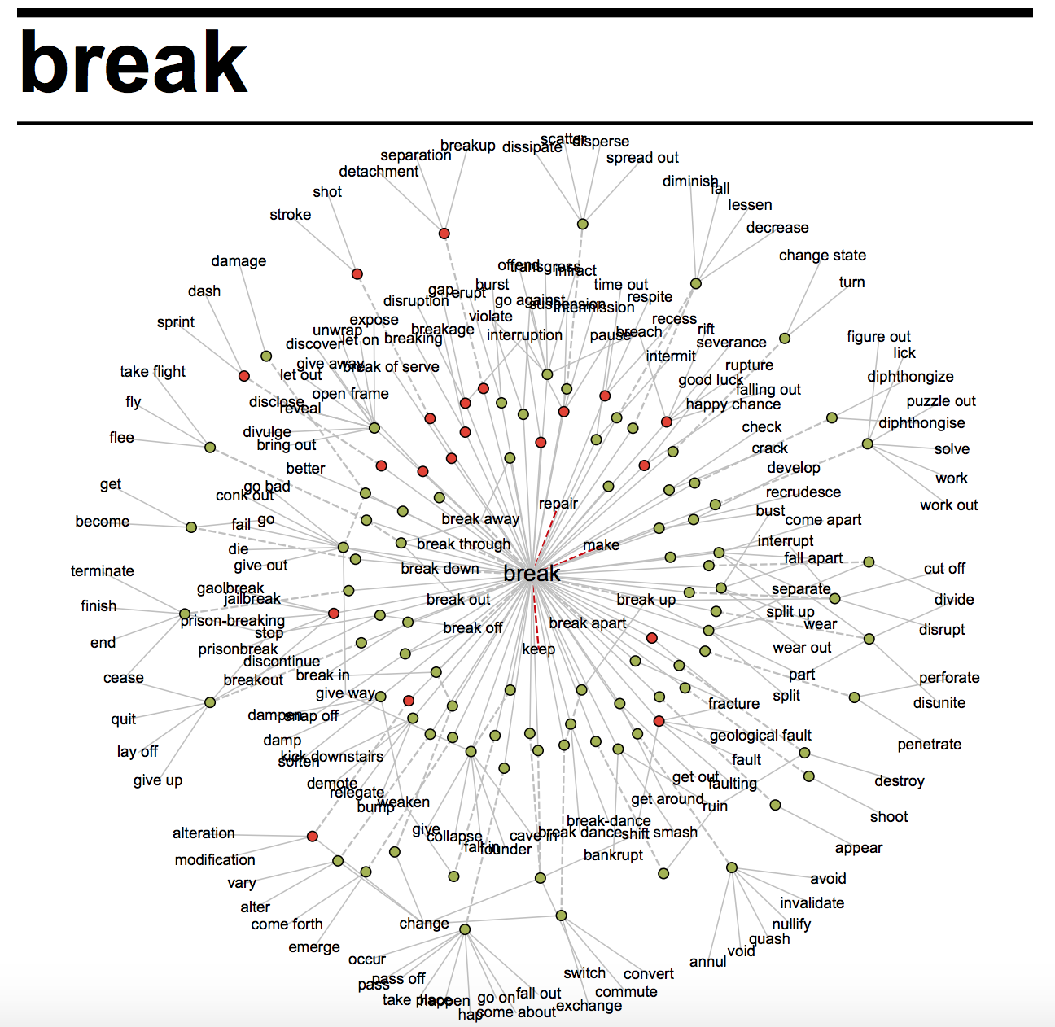

Slide 28
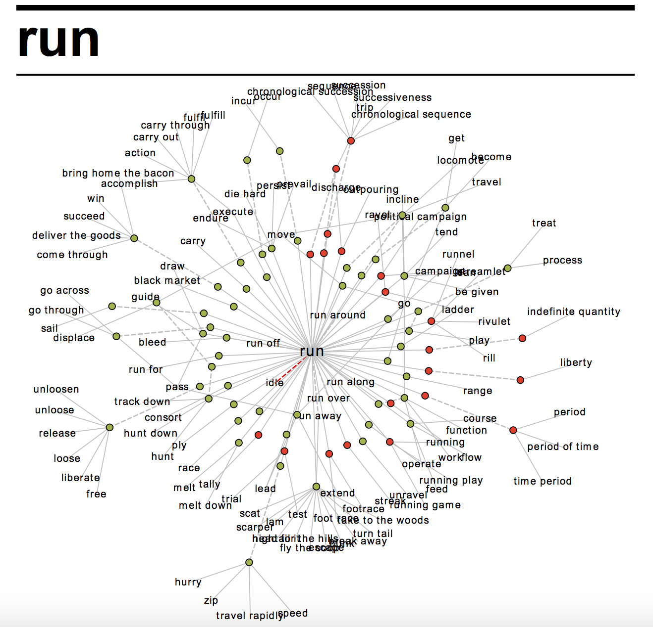

Slide 29
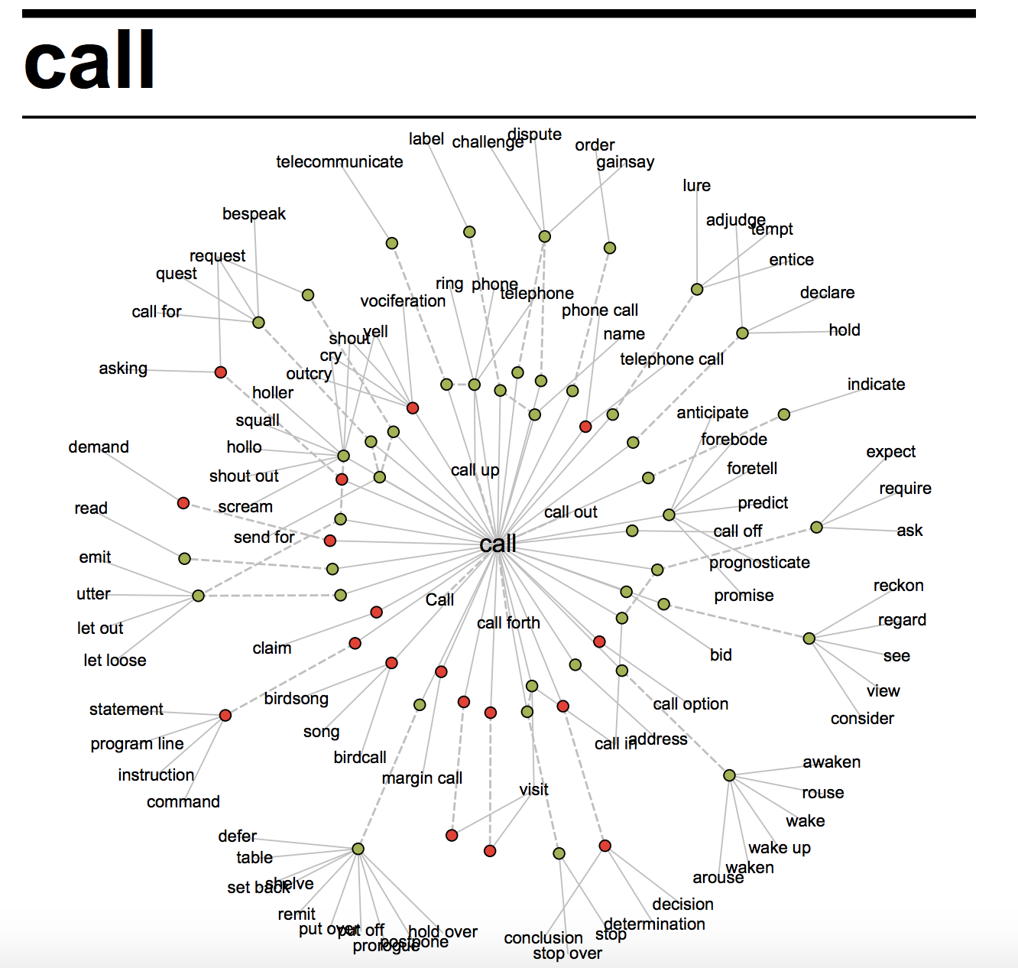

Slide 30
Examples of “break” in random fiction contexts (from COCA)
She left the break room
He forced himself to break into a run again
I don't want to break anyone's heart
The urge to break the rules
waited for a break in traffic
Max moved to break down and clean the soda dispensers
I can make or break my own reputation

Slide 31

Vocabulary With Many Context Dependent Meanings
High-Frequency Anglo-Saxon Words like:
break
run
call
Multiple Meanings best Learned through many Context Exposures during:
Oral Conversation
Extensive Reading
of Narrative Fiction

Slide 32
Typical examples of words
in expository (informational) texts
Greek and Latin

Slide 33
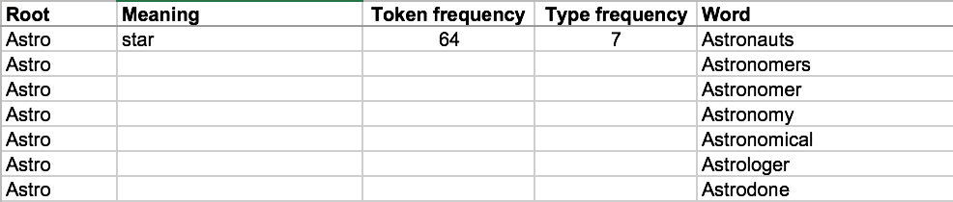
From 5th Grade Reading Materials
Adapted from Markovic (2002)

Slide 34
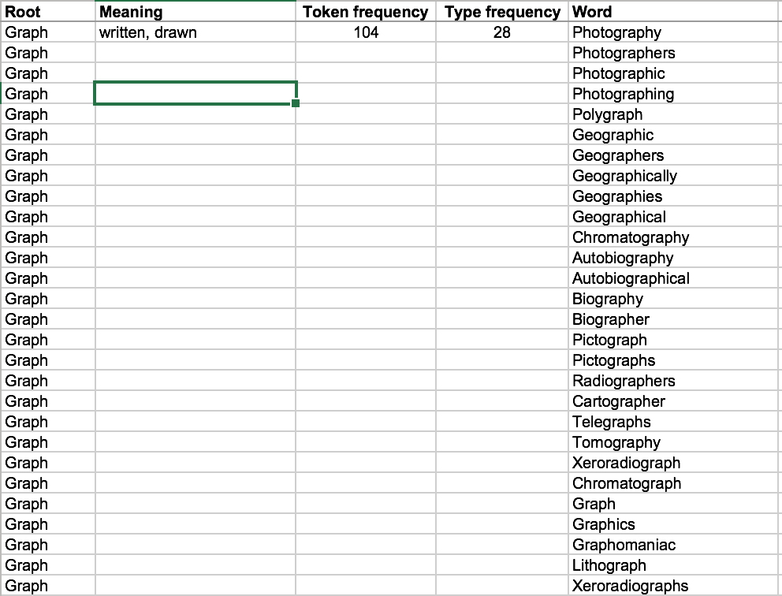

Adapted from Markovic (2002)

Slide 35
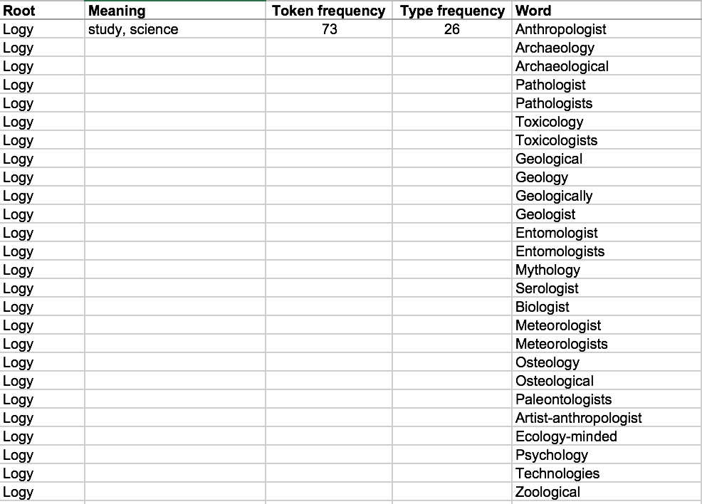
Adapted from Markovic (2002)

Slide 36
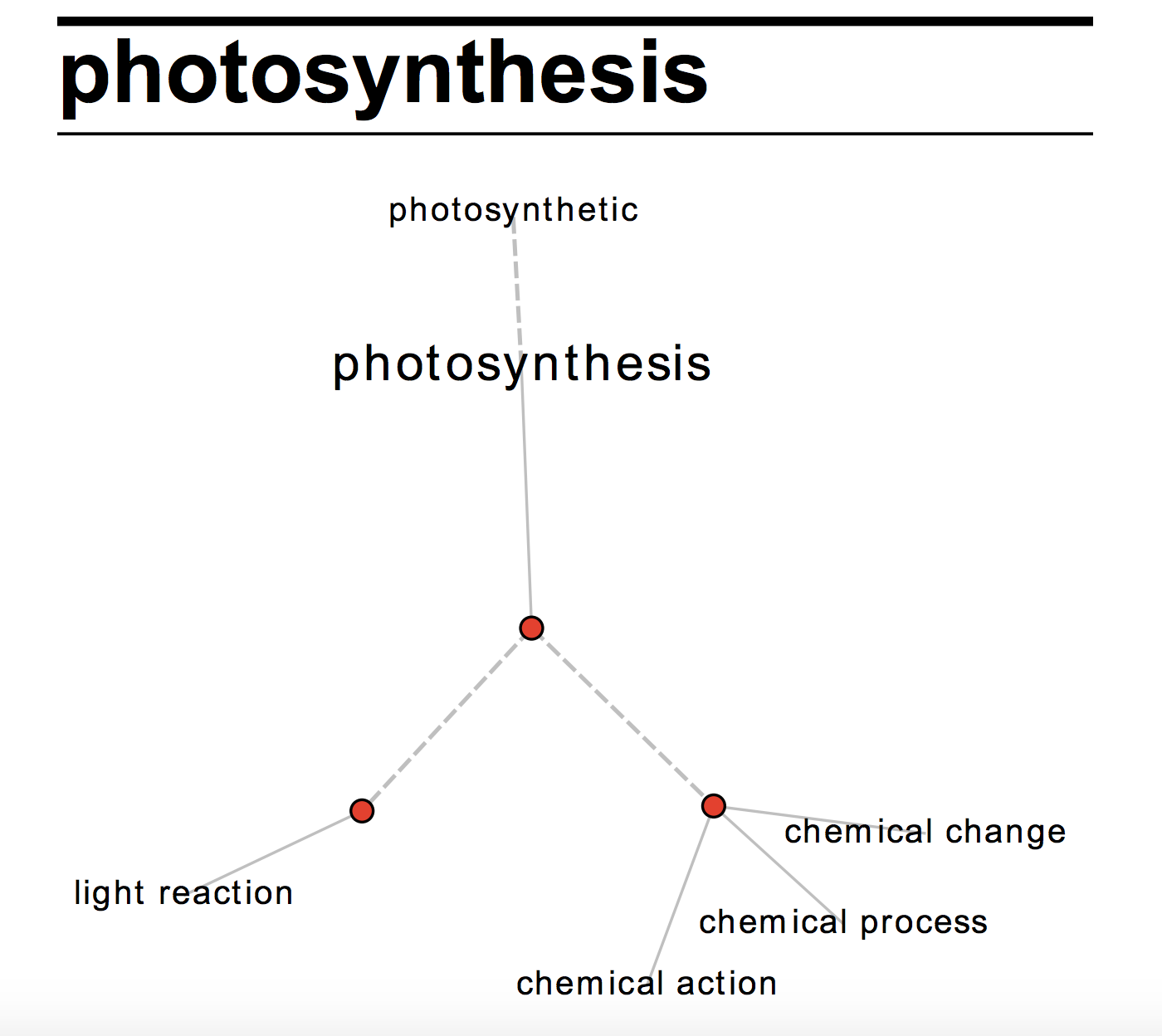

Slide 37
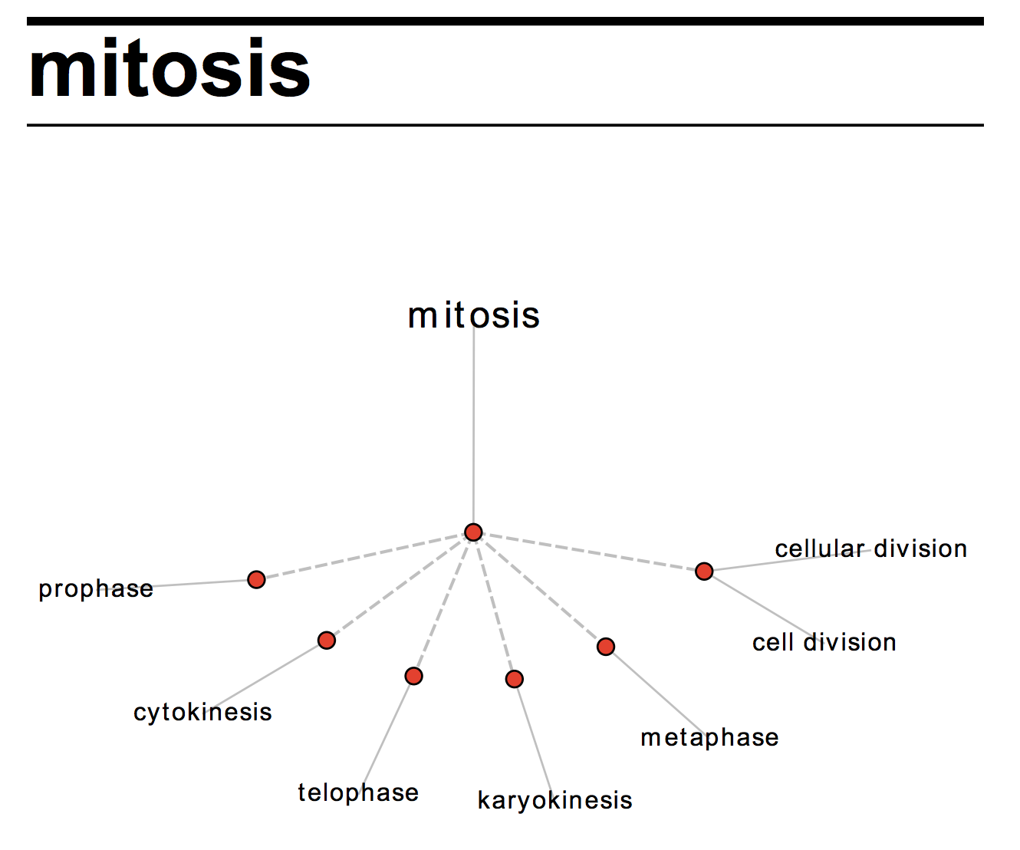

Slide 38
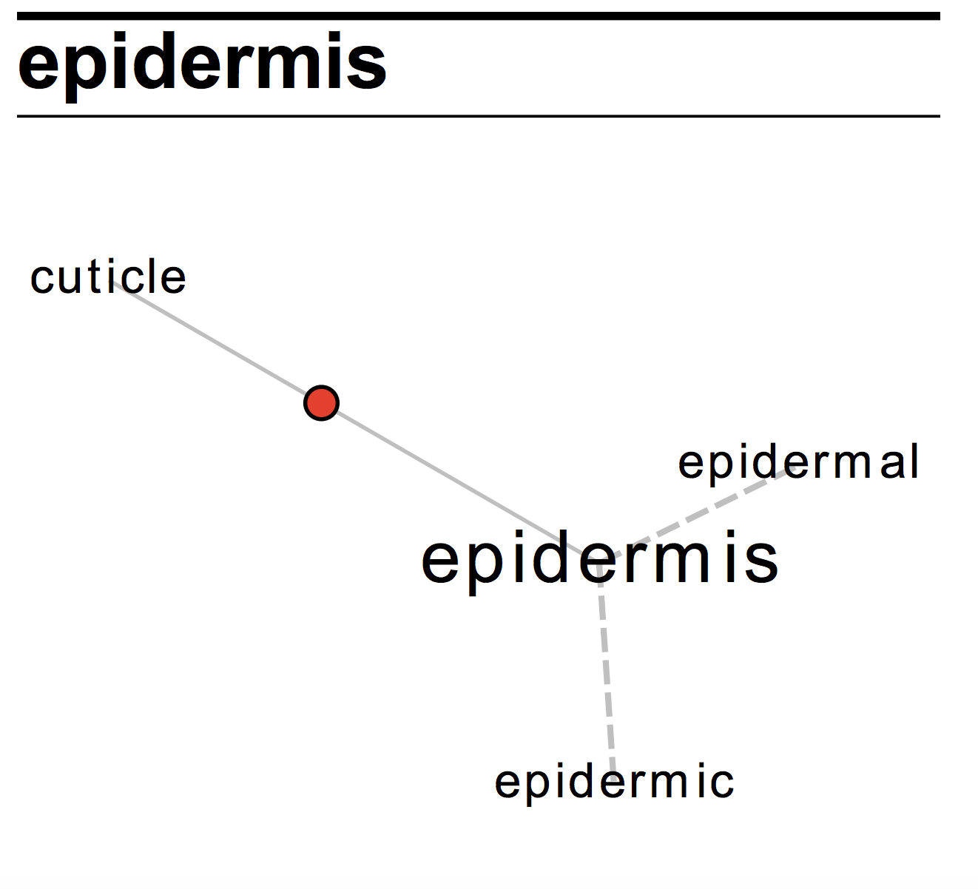

Slide 39
“Mitosis” in Typical Expository Contexts
the kinetochore is a multiproteinchromatin complex at which the forces of mitosis work to congress and later to separate chromosomes into daughter cells
these antibodies have been localizedto kinetochores during mitosis but also reveal prekinetochores present during interphase
Source: Gardner, D. (2013). Exploring vocabulary: Language in action. London: Routledge

Slide 40
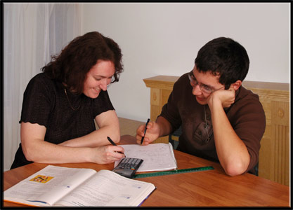
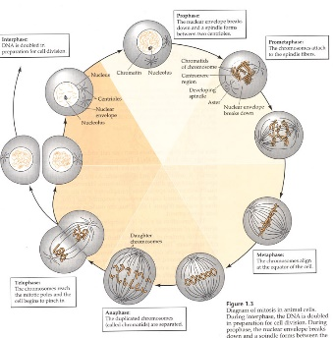
Vocabulary With Context Free Meanings
Technical Academic Words like:
photosynthesis
mitosis
epidermis
Meanings difficult for ELLs and struggling Native Speakers to learn through context exposures alone.
Learning must be supported by various forms of:
Direct Vocabulary Instruction

Slide 41
95-98%
Vocabulary Threshold
for
Basic Reading Comprehension

Slide 42
When we are -------- -----, I ---- that your ---- of the ---------- ------ ------
-------- -------- will be -------* -------,
---------- with ------- to the --------------- ------------ between ------- --------- and ---------- ---------.
44% Word Knowledge

Slide 43
When we are -------- today, I ---- that your ---- of the --------- facing ------language -------- will be ------- forever, ---------- with ------- to the
---------- ------------between reading --------- and vocabulary ---------.
63% Word Knowledge

Slide 44
When we are finished today, I hope that your view of the --------- facing second language learners will be changed forever, ---------- with ------- to the ---------- relationship between reading abilities and vocabulary knowledge.
88% Word Knowledge

Slide 45
When we are finished today, I hope that your view of the challenges facing second language learners will be changed forever, especially with regard to the ---------- relationship between reading abilities and vocabulary knowledge.
97% Word Knowledge

Slide 46
Test Question:
What kind of relationship exists between vocabulary knowledge and reading abilities?

Slide 47
When we are finished today, I hope that your view of the challenges facing second language learners will be changed forever, especially with regard to the reciprocal relationship between reading abilities and vocabulary knowledge.
100% Word Knowledge

Slide 48
The Gate-keeping Tests of Education
are Primarily Tests of Reading Ability
By Extension,
They are also Tests of
Robust Vocabulary Knowledge

Slide 49
SAT
ACT
LSAT
GRE
GMAT
MCAT

Slide 50
From WIDA Standards Framework
“Lexicon in academic settings consists of general, technical and academic words.”

Slide 51
----General------
------------- Academic Core----------------
-----------Technical-----------

Slide 52
Rank AVL Lemma POS
1 study n
2 group n
3 system n
4 social j
5 provide v
6 however r
7 research n
8 level n
9 result n
10 include v
11 important j
12 process n
13 use n
14 development n
15 data n
16 information n
17 effect n
18 change n
19 table n
20 policy n
Saturated with “Academic Sense”
Gardner & Davies (2014)

Slide 53
MEDICINE/HEALTH
174 HEALTH (n)
260 PATIENT (n)
323 TEST (n)
395 CARE (n)
399 RISK (n)
402 FOOD (n)
414 TREATMENT (n)
447 DRUG (n)
506 TRAINING (n)
524 WEEK (n)
549 DISEASE (n)
630 MEDICAL (j)
PRESSURE (n)
CELL (n)
6018 ARTHRITIS (n)
6044 PLACEBO (n)
6083 ENDURANCE (n)
6089 CONTAMINANT (n)
6103 HIGH-RISK (j)
6106 RECURRENCE (n)
6143 SPA (n)
6160 METABOLISM (n)
6170 AIRWAY (n)
6176 MERCURY (n)
6180 LEAN (j)
ABS (n)
6192 THUMB (n)
6195 NITRATE (n)
SCIENCE/TECHNOLOGY
545 STAR (n)
552 SPECIES (n)
557 PLANT (n)
634 CELL (n)
682 SCIENTIST (n)
725 SURFACE (n)
747 EARTH (n)
908 SOFTWARE (n)
1035 FOREST (n)
1086 SUN (n)
1147 FISH (n)
1154 PLANET (n)
1219 TEMPERATURE (n)
TELESCOPE (n)
5421 STELLAR (j)
5423 SIMULATE (v)
5426 MAGNET (n)
5427 SHUTTLE (n)
5442 VECTOR (n)
5455 ALTITUDE (n)
5511 PIXEL (n)
5517 BIOMASS (n)
5553 GENETICALLY (r)
5559 UPDATE (n)
5583 NEUTRON (n)
5609 CELESTIAL (j)
5620 BUFFER (n)
5623 OPTICS (n)
HUMANITIES
231 ART (n)
280 MUSIC (n)
537 TEXT (n)
624 OBJECT (n)
685 CHARACTER (n)
733 READER (n)
797 STYLE (n)
830 CURRICULUM (n)
855 FILM (n)
973 READING (n)
1004 WRITING (n)
1007 ARTIST (n)
1011 LOVE (n)
1037 EDUCATOR (n)
5820 AESTHETICS (n)
5827 CONDUCTOR (n)
5907 SENSIBILITY (n)
5914 CATHEDRAL (n)
5924 SYMPOSIUM (n)
5938 SPECTACLE (n)
5945 BOURGEOIS (j)
5964 ARTICULATION (n)
5972 HUMANITIES (n)
5974 GUITAR (n)
5977 IMPROVISATION (n)
5985 SUBJECTIVITY (n)
6005 CANVAS (n)
6037 IMITATE (v

Slide 54
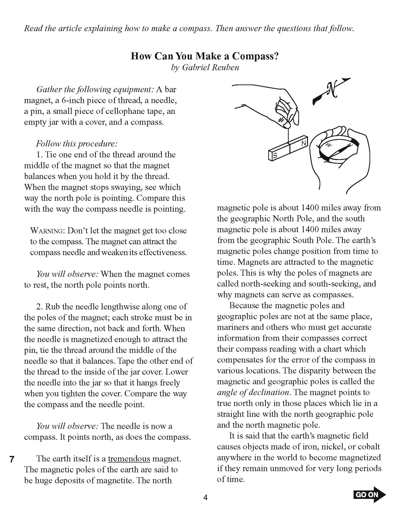
NECAP
Example
Fifth Grade

Slide 55
NECAP Example 5th Grade
This is why the poles of magnets are called north seeking and south seeking and why magnets can serve as compasses. Because the magnetic poles and geographic poles are not at the same place, mariners and others who must get accurate information from their compasses correct their compass reading with a chart which compensates for the error of the compass in various locations. The disparity between the magnetic and geographic poles is called the angle of declination. The magnet points to true north only in those places which lie in a straight line with the north geographic pole and the north magnetic pole

Slide 56
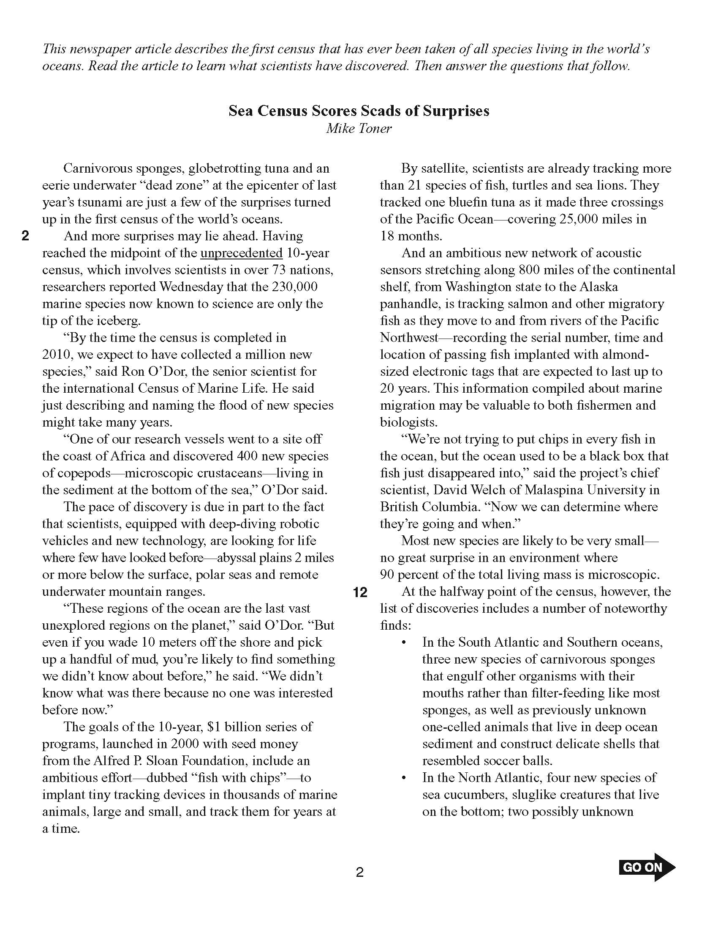
NECAP
11th Grade
Example

Slide 57
NECAP Example 11th Grade
at the halfway point of the census however the
list of discoveries includes a number of noteworthy
finds in the south Atlantic and southern oceans
three new species of carnivorous sponges
that engulf other organisms with their
mouths rather than filter- feeding like most
sponges as well as previously unknown
one-celled animals that live in deep ocean
sediment and construct delicate shells that
resembled soccer balls

Slide 58
Practical ELL Vocabulary Training Decisions
in K-12 Academic Settings
1. Vocabulary training should benefit both ELLs and native English speakers in the classroom.
2. Vocabulary training should address words, word parts, and phrases with high utility = Big Bang for the Buck.
Frequently used Greek and Latin Roots and Affixes that appear in many words in the content areas of education. Greek and Latin Roots on Wikipedia (one of many lists available) http://quizlet.com/
B. Academic Vocabulary List (AVL) http://www.wordandphrase.info/academic/
https://Quizlet.com/Academic_Vocab_List
C. Content words and phrases that actually appear several times in the texts and topics that learners are required to read now or in the near future.
D. Words and phrases that are typically found in task instructions

Slide 59
3. Design a curriculum to maximize the recycling of a smaller group of content words at one time, and provide ample practice with these small groups of words
A. Tight themes in the content areas
• Mummies and Bone Detectives instead of Mysteries
• The Gold Rush and The Oregon Trail instead of Westward Movement
• Bees and Butterflies instead of Insects
B. Base the curriculum on informational texts, with theme-related fiction used to supplement and enrich.
4. Find and use informational texts of varying difficulty levels that address the same content-area themes and contain some of the same vocabulary terms so that ELLs and struggling L1 readers can have better success at reading academic text, while staying on topic with the rest of the class.
5. Design a curriculum that allows words to be experienced in all four modalities (listening, speaking, reading, writing), preferably at or near the same time.
6. Approach vocabulary training with the aim of helping your ELLs become autonomous word learners.

Slide 60
7. Spend ample class time on direct word study, looking at words, word parts, and phrases from actual texts and tasks used in your classroom.
A. Morphological Awareness Raising (Greek & Latin Roots, Prefixes, Suffixes)
B. Context Dependent Meanings of Words with Many Meanings (run, break, etc.)
C. The Phrasal Nature of many English vocabulary items:
- Compounds (cell membrane, carbon dioxide, etc.)
- Complex Discourse Markers (in contrast, on the other hand, on the contrary, etc.)
- Academic Bundles (The fact that. . .; The point is . . ., etc.)
- Idioms (bit off more than we could chew, etc.)
- Phrasal Verbs (break up, break out, break down, etc.)
8. If your school has pull-out ELL instruction or private tutoring options, insist that these efforts are correlated with mainstream classroom content, including the vocabulary necessary to succeed in the mainstream setting.

Slide 61
Vocabulary Centered Curriculum
What English is Needed?
Academic? Business? Vocational?
What Texts and Tasks?
Textbooks? Contracts? Manuals?
Listening
Speaking
Vocabulary
What Vocabulary?
in texts and tasks?
in learners’ minds?
needing instruction?
What Curriculum?
Integrated Skills
Theme-Based
Reading
Writing
What Strategies?
Morphological Awareness
Dictionaries, etc.
Using Context

Slide 62
Vocabulary Teaching
Pedagogy
Dee Gardner
Brigham Young University
TESOL
Seattle 2017
Dee_Gardner@byu.edu

Slide 63
Online Resources
Word and Phrase Academic
Academic Vocabulary List
Academic Vocabulary List Quizlet
COCA
Wikipedia Corpus
Tutorial for Wikipedia Corpus
Lextutor
AntConc

Slide 64
REFERENCES
Anderson, R. C. (1996). Research foundations to support wide reading. In V. Greaney (Ed.), Promoting reading in developing countries (pp. 55-77). Newark, Delaware: International Reading Association.
Biemiller, A. (1999). Language and reading success. Newton Upper Falls, MA: Brookline Books.
Corson, D. (1997). The learning and use of academic English words. Language Learning, 47(4), 671-718.
Coté, N., Goldman, S. R., & Saul, E. U. (1998). Students making sense of informational text: Relations between processing and representation. Discourse Processes, 25(1), 1-53.
Gardner, D. (2013). Exploring vocabulary: Language in Action. London: Routledge.
Gardner, D., & Davies, M. (2014). A new academic vocabulary list. Applied Linguistics, 35(3), 305-327.
Goldenberg, C. (2008). Teaching English language learners: What the research does—and does not—say. American Educator, Summer, 8-44.
Ippolito, J., Steele, J. L., & Samson, J. F. (2008). Introduction: Why adolescent literacy matters now. Harvard Educational Review, 78(1), 1-6.
Jacobs, V. A. (2008). Adolescent literacy: Putting the crisis in context. Harvard Educational Review, 78(1), 7-39.
Markovic, J. (2002). The influence of Greek and Latin on the lexicon of narrative and expository text collections in upper-elementary education: Implications for extensive reading. MA Thesis, Brigham Young University.

