Slide 1
Vocabulary as Key to Global Competence in English Norbert Schmitt University of Nottingham

Slide 2
Global English in Today’s World
Second languages are widely learned and spoken around the world
Monolingualism is the exception, rather than the norm
English is the most studied second language in the world
English is the lingua franca (common language) of the world → Global English

Slide 3
English Speakers
1500 4 million speakers
1600 6 million speakers
1700 8.5 million speakers
1800 20-40 million speakers
1900 116-123 million speakers
2018 ____?

Slide 4
English Speakers
1500 4 million speakers
1600 6 million speakers
1700 8.5 million speakers
1800 20-40 million speakers
1900 116-123 million speakers
2018 ~ 335 million speakers

Slide 5
English Speakers
English ~ 335 million
Chinese ____?
Spanish ____?

Slide 6
English Speakers
1. Chinese ~ 1,197 million
2. Spanish ~ 400 million
3. English ~ 335 million

Slide 7
English Speakers
1. Chinese ~ 1,197 million
2. Spanish ~ 400 million
3. English ~ 335 million
BUT: English has by far the most second language speakers, perhaps as many as ONE BILLION.

Slide 8
The Importance of English in Today’s World
Around ____ of the books published annually are in English
a. 12%
b. 25%
c. 33%
d. 42%

Slide 9
The Importance of English in Today’s World
Around ____ of the books published annually are in English
a. 12%
b. 25%
c. 33%
d. 42%

Slide 10
Internet
____ of the ten million most visited internet web sites are in English.
a. 26%
b. 41%
c. 56%
d. 73%

Slide 11
Internet
____ of the ten million most visited internet web sites are in English.
a. 26%
b. 41%
c. 56%
d. 73%
German and Russian sites are a distant second place (6%).

Slide 12
Tweets
Percentage of daily Tweets:
Match the languages and percentages:
___ English a. 34%
___ Japanese b. 16%
___ Spanish c. 12%

Slide 13
Tweets
Percentage of daily Tweets:
Match the languages and percentages:
34% English
16% Japanese
12% Spanish

Slide 14
Cinema
55 countries with cinema data
In 40 of them (73%) the top 7 most-viewed films were in English
In 21 countries (38%) all of the top 10 films were in English

Slide 15
World Institutions
Which of the following use English as an official language?
___ EU
___ Olympics
___ World Bank
___ United Nations
___ Aviation
___ Maritime traffic

Slide 16
World Institutions
Which of the following use English as an official language?
✓ EU
___ Olympics
___ World Bank
___ United Nations
___ Aviation
___ Maritime traffic

Slide 17
World Institutions
Which of the following use English as an official language?
✓ EU
✓ Olympics
___ World Bank
___ United Nations
___ Aviation
___ Maritime traffic

Slide 18
World Institutions
Which of the following use English as an official language?
✓ EU
✓ Olympics
✓ World Bank
___ United Nations
___ Aviation
___ Maritime traffic

Slide 19
World Institutions
Which of the following use English as an official language?
✓ EU
✓ Olympics
✓ World Bank
✓ United Nations
___ Aviation
___ Maritime traffic

Slide 20
World Institutions
Which of the following use English as an official language?
✓ EU
✓ Olympics
✓ World Bank
✓ United Nations
✓ Aviation
___ Maritime traffic

Slide 21
World Institutions
Which of the following use English as an official language?
✓ EU
✓ Olympics
✓ World Bank
✓ United Nations
✓ Aviation
✓ Maritime traffic

Slide 22
Academic Journals
English is main language of communication in the scientific community
About what percentage of all the academic journals listed in Scopus (a database of academic publications) are published in English?
0% 100%

Slide 23
Academic Journals
English is main language of communication in the scientific community
About what percentage of all the academic journals listed in Scopus (a database of academic publications) are published in English?
~80%
0% 100%

Slide 24
ESL Testing
Huge numbers of people are learning English as a second language worldwide
This is illustrated by the very large numbers of people taking tests of English proficiency every year

Slide 25
ESL Testing
For example, in 2013, the International English Language Testing System (IELTS) test was taken by more than:
0.5 million people in more than 50 countries
1.0 million people in more than 85 countries
1.5 million people in more than 105 countries
2.0 million people in more than 130 countries

Slide 26
ESL Testing
The International English Language Testing System (IELTS) test was taken by more than:
2.0 million people in more than 130 countries
The TOEFL exam was taken by a similar number
Several other tests measuring hundreds of thousands

Slide 27
Punchlines
Second languages are essential to communicate in the wider global context
Language teaching is a booming business
worldwide
English is the most important/useful of the second languages Global English

Slide 28
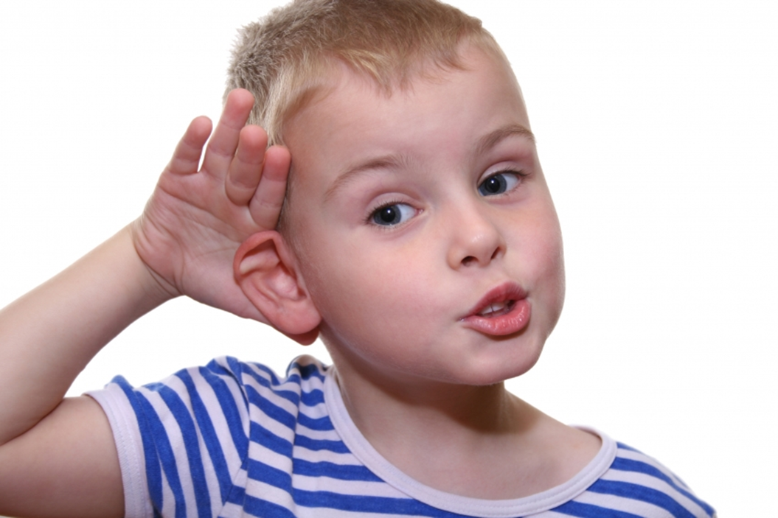
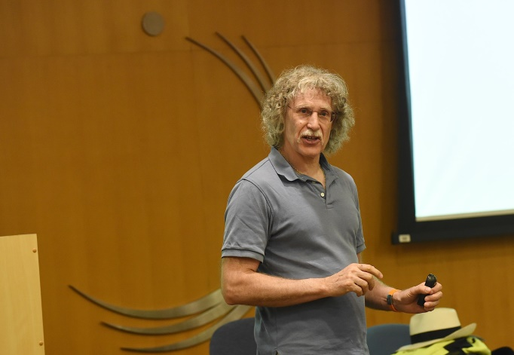
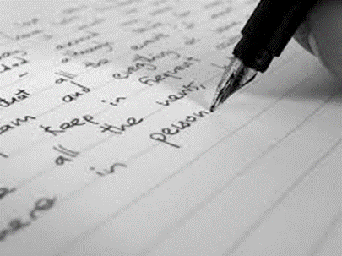
How Much Vocabulary is Needed to Use English?

Slide 29
How Much Vocabulary is Needed to Use English?

Slide 30
Reading

Slide 31
Schmitt, Gardner, Davies, & Schmitt (in preparation)

Slide 32
Listening

Slide 33
Schmitt, Gardner, Davies, & Schmitt (in preparation)
Spoken Genre in Lemmas (≈300,000)
TV TV
Coverage Conv Lecture Radio talkshow sitcom
95% 1,500 2,700 3,500 3,400 2,900
98% 3,100___ 5,000___6,400__ 6,500____ 5,600
Conv = conversation

Slide 34
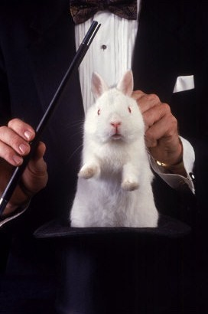
Where do these numbers come from anyway?

Slide 35
Vocabulary size requirement estimates
Where do these figures come from?
Studies combining:
Vocabulary coverage:
The percentage of words known in a text
Reading comprehension:
The percentage of information which can be taken from a text

Slide 36
Fat City (95% coverage)
In December, to the delight of many __________ and the ______ of many doughnut lovers, the New York City Board of Health voted to ban artificial trans fats from restaurants, school cafeterias, pushcarts, and almost every other food-service establishment it oversees, which includes most everything except hospitals. Trans fats don’t occur naturally in the things people like but feel guilty eating, or at least not at high levels (there are small proportions in the fat in meat and dairy products). But artificial ones are plentiful in commercial foods, because they are easy to use, cheaper than natural fats, and keep practically forever. Trans fats are made by pumping _______ gas into liquid fats usually in the presence of _____ so that they will remain solid at room temperature, like butter and ___; and they have the same wonderful properties in pie crusts, cookies, and cakes. Crisco, still _____ for solid shortening made by partial ___________ (of cottonseed oil), soon became the “______” choice for pie crust and fried chicken, making pastry almost as flaky and skin almost as crisp as ___ does.

Slide 37
Fat City (95% coverage)
In December, to the delight of many cardiologists and the dismay of many doughnut lovers, the New York City Board of Health voted to ban artificial trans fats from restaurants, school cafeterias, pushcarts, and almost every other food-service establishment it oversees, which includes most everything except hospitals. Trans fats don’t occur naturally in the things people like but feel guilty eating, or at least not at high levels (there are small proportions in the fat in meat and dairy products). But artificial ones are plentiful in commercial foods, because they are easy to use, cheaper than natural fats, and keep practically forever. Trans fats are made by pumping hydrogen gas into liquid fats usually in the presence of nickel so that they will remain solid at room temperature, like butter and lard; and they have the same wonderful properties in pie crusts, cookies, and cakes. Crisco, still generic for solid shortening made by partial hydrogenation (of cottonseed oil), soon became the “sanitary” choice for pie crust and fried chicken, making pastry almost as flaky and skin almost as crisp as lard does.

Slide 38
The Truth About Beauty (98% coverage)
Cosmetics makers have always sold “hope in a jar” – creams and ______ that promise youth, beauty, sex appeal, and even love for the women who use them. Over the last few years, the marketers at Dove have added some new-and-improved __________. They’re now promising self-esteem and cultural transformation. Dove’s “Campaign for Real Beauty,” declares a press release, is “a global effort that is intended to serve as a starting point for societal change and act as a ______ for widening the definition and discussion of beauty.” Along with its thigh-firming creams, self-tanners, and hair conditioners, Dove is peddling the crowd-pleasing notions that beauty is a media creation, that recognizing plural forms of beauty is the same as declaring every woman beautiful, and that self-esteem means ignoring imperfections.

Slide 39
The Truth About Beauty (98% coverage)
Cosmetics makers have always sold “hope in a jar” – creams and potions that promise youth, beauty, sex appeal, and even love for the women who use them. Over the last few years, the marketers at Dove have added some new-and-improved enticements. They’re now promising self-esteem and cultural transformation. Dove’s “Campaign for Real Beauty,” declares a press release, is “a global effort that is intended to serve as a starting point for societal change and act as a catalyst for widening the definition and discussion of beauty.” Along with its thigh-firming creams, self-tanners, and hair conditioners, Dove is peddling the crowd-pleasing notions that beauty is a media creation, that recognizing plural forms of beauty is the same as declaring every woman beautiful, and that self-esteem means ignoring imperfections.

Slide 40
Vocabulary Coverage vs. Reading Comprehension

Slide 41
Vocabulary Coverage vs. Reading Comprehension

Slide 42
Vocabulary Coverage vs. Reading Comprehension

Slide 43
Schmitt, Jiang, and Grabe (2011)

Slide 44
Listening

Slide 45
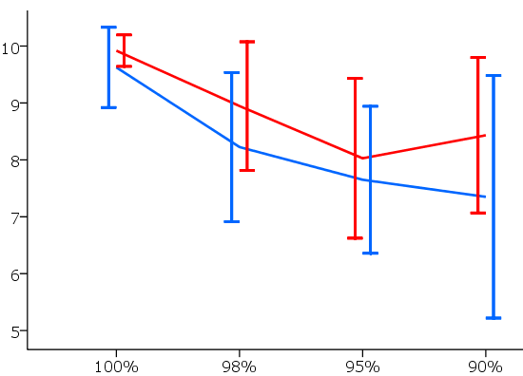
Van Zeeland & Schmitt (2013)
Native speakers Non-native speakers
Comprehension
Coverage

Slide 46
Van Zeeland & Schmitt (2013)
Native speakers Non-native speakers
Comprehension
Coverage

Slide 47
Non-native speakers (N=40)
 | Coverage
Comprehension score | 100% | 98% | 95% | 90%
3 4 5 6 7 8 9 10 | 0 0 0 0 1 2 8 29 | 0 0 1 3 7 12 9 8 | 0 0 1 9 6 14 7 3 | 5 0 2 3 9 6 10 5
Mean score | 9.62 | 8.22 | 7.65 | 7.35
Standard deviation | .70 | 1.31 | 1.29 | 2.13

Slide 48
Punchlines
English is important to operate in
a global world

Slide 49
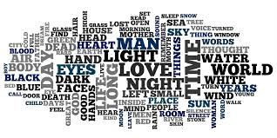
Punchlines
It takes a lot of vocabulary to use English

Slide 50
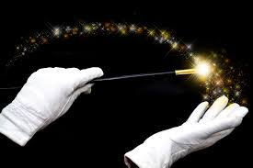
Punchlines
This much vocabulary will not just be ‘picked up’ as if by magic

Slide 51
Punchlines
We need to teach vocabulary in a sustained and principled manner

Slide 52
Principles for Teaching English as a Second Language

Slide 54
Principles of Vocabulary Teaching and Learning
A lot of vocabulary is necessary to function well in English
Learning vocabulary entails more than just learning a word’s form and meaning
Vocabulary learning is incremental in nature
Recycling is crucial to vocabulary learning
There is a role for both explicit instruction and incidental learning
Vocabulary is more than just individual words

Slide 55
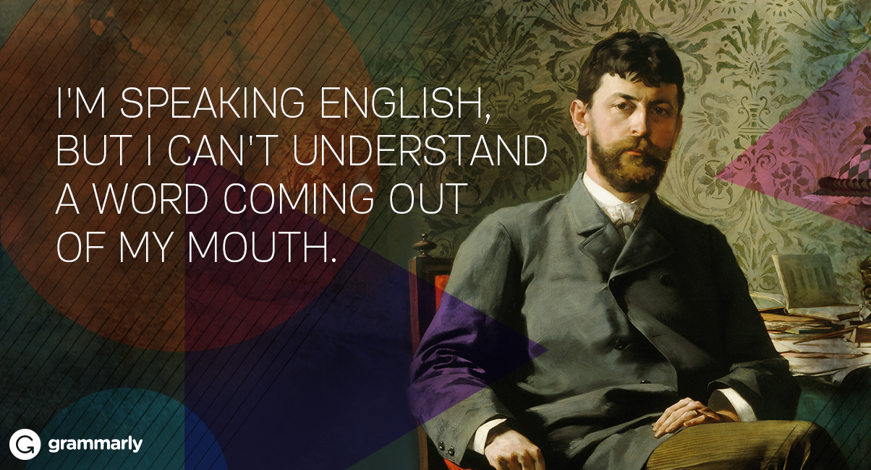
‘Knowing’ a Word
What is meant by ‘known’?

Slide 56
There is More to Knowledge than Just Meaning and Form
meaning
spelling
pronunciation
associations
grammar
word
collocations
frequency
formality
connotation

Slide 57
There is More to Knowledge than Just Meaning and Form
meaning
spelling
pronunciation
associations
grammar
word
collocations
frequency
formality
connotation

Slide 58
A Word’s Form May Be More Difficult Than Its Meaning
The flag is the nation symbol.
I get a lot of enjoy from listening
to music.
When she heard the good news, she smiled happy.

Slide 59
A Word’s Form May Be More Difficult Than Its Meaning
The flag is the national symbol.
I get a lot of enjoyment from listening to music.
When she heard the good news, she smiled happily.

Slide 60
Schmitt & Zimmerman (2002)
persist
Noun The judge changed his mind because
of the lawyer’s ________.
Verb The lawyer ________ until the judge
changed his mind.
Adjective The ________ lawyer persuaded the
judge to change his mind.
Adverb The lawyer argued ________.

Slide 61
Schmitt & Zimmerman (2002)
persist
Noun The judge changed his mind because
of the lawyer’s persistence.
Verb The lawyer persisted until the judge
changed his mind.
Adjective The persistent lawyer persuaded the
judge to change his mind.
Adverb The lawyer argued persistently.

Slide 62
Schmitt & Zimmerman (2002)
Nottingham and California university students
Advanced learners typically knew some, but not all derivative forms (2 or 3 out of 4)
Typically knew noun and verb forms better than adjective and adverb forms

Slide 63
Collocations
Powerful coffee ?
Strong coffee ?
Heavy coffee ?
Powerful rain ?
Strong rain ?
Heavy rain ?

Slide 64
Collocations
Powerful coffee 
Strong coffee ?
Heavy coffee ?
Powerful rain ?
Strong rain ?
Heavy rain ?

Slide 65
Collocations
Powerful coffee 
Strong coffee ✓
Heavy coffee ?
Powerful rain ?
Strong rain ?
Heavy rain ?

Slide 66
Collocations
Powerful coffee 
Strong coffee ✓
Heavy coffee 
Powerful rain ?
Strong rain ?
Heavy rain ?

Slide 67
Collocations
Powerful coffee 
Strong coffee ✓
Heavy coffee 
Powerful rain 
Strong rain ?
Heavy rain ?

Slide 68
Collocations
Powerful coffee 
Strong coffee ✓
Heavy coffee 
Powerful rain 
Strong rain ?
Heavy rain ?

Slide 69
Collocations
Powerful coffee 
Strong coffee ✓
Heavy coffee 
Powerful rain 
Strong rain ?
Heavy rain ✓

Slide 70
Various Kinds Of Word Knowledge Are Needed
Learning a word requires more than just learning just its meaning and form
Must learn all of the ‘contextual’ kinds of word knowledge as well
These are more difficult to learn explicitly, and might require large amounts of exposure
Need explicit learning + extensive exposure

Slide 71
Vocabulary Learning Is Incremental
Each of the components are mastered along a continuum:
No Knowledge Complete Mastery

Slide 72
Schmitt (2010)
Written Form
Can’t spell knows some phonologically fully
at all letters correct correct
spelling
?? r????y reely really✓

Slide 73
Vocabulary Learning is Incremental
Derivative Forms
nation nation nation nation
national national national
nationalize nationalize
nationally
nationalization …

Slide 74
Initial Knowledge of Word
Spoken form
Written form
Meaning
Grammar
Collocation
Register
Frequency
Associations

Slide 75
Developing Knowledge of Word
Spoken form
Written form
Meaning
Grammar
Collocation
Register
Frequency
Associations

Slide 76
Advanced Knowledge of Word
Spoken form
Written form
Meaning
Grammar
Collocation
Register
Frequency
Associations

Slide 77
Vocabulary Learning is Incremental
Learning a word requires more than just learning just its meaning and form
Must learn all of the ‘contextual’ kinds of word knowledge as well
These are more difficult to explicitly learn, and might require large amounts of exposure
Need explicit learning + extensive exposure

Slide 78
Recycling is Crucial to Vocabulary Learning
Words need to be recycled because it takes time to:

Slide 79
Recycling is Crucial to Vocabulary Learning
Words need to be recycled because it takes time to:
◆ Consolidate what you have learned

Slide 80
Recycling is Crucial to Vocabulary Learning
Words need to be recycled because it takes time to:
◆ Consolidate what you have learned
◆ Move up the developmental scale

Slide 81
Recycling is Crucial to Vocabulary Learning
Words need to be recycled because it takes time to:
◆ Consolidate what you have learned
◆ Move up the developmental scale
◆ Master the various types of word
knowledge components

Slide 82
Recycling is Crucial to Vocabulary Learning
Words need to be recycled because it takes time to:
◆ Consolidate what you have learned
◆ Move up the developmental scale
◆ Master the various types of word
knowledge components

Slide 83
Recycling is Crucial to Vocabulary Learning
Words need to be recycled because it takes time to:
◆ Consolidate what you have learned
◆ Move up the developmental scale
◆ Master the various types of word
knowledge components
Recycling is as much about enhancement as consolidation

Slide 84
Forgetting
Memory
-In what manner does the mind forget?
100
0
Time →
A B C

Slide 85
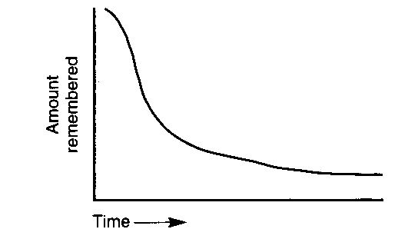
Forgetting

Slide 86
Revision Schedule
Some revision needs to be done soon after learning session
Revision needs to be spaced
One efficient revision schedule is ‘expanding rehearsal’:
- 5-10 minutes after study session
- 24 hours later
- 1 week later
- 1 month later
- 6 months later

Slide 87
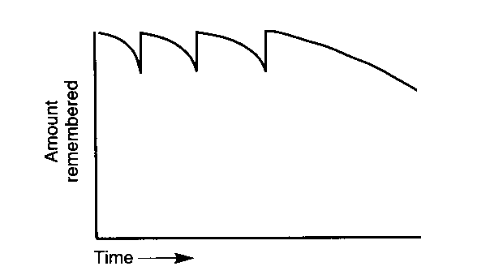
Maintaining Knowledge

Slide 88
Explicit Learning and Extensive Exposure
Explicit study leads to learning that is typically:
Faster
Stronger
More durable
But you can’t teach enough words
Extensive exposure provides necessary repetition
It also provides information about contextual types of word knowledge that are hard to teach

Slide 89
Spelling can be Taught Explicitly
a. grieve OR
b. greive
c. recieve OR
d. receive

Slide 90
Spelling can be Taught Explicitly
a. grieve ✓
b. greive
c. recieve
d. receive ✓
‘i’ before ‘e’, except after ‘c’

Slide 91
Intuitions of Spelling
isozyme
ptardine
prolificity
tcharal
quintain
hgough
nulliparous
louqt

Slide 92
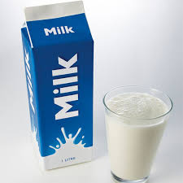
Intuitions of Spelling
isozyme 
ptardine
prolificity
tcharal
quintain
hgough
nulliparous
louqt

Slide 93
Intuitions of Spelling
isozyme 
ptardine 
prolificity
tcharal
quintain
hgough
nulliparous
louqt

Slide 94
Intuitions of Spelling
isozyme 
ptardine 
prolificity  (prolific power or character)
tcharal
quintain
hgough
nulliparous
louqt

Slide 95
Intuitions of Spelling
isozyme 
ptardine 
prolificity 
tcharal 
quintain
hgough
nulliparous
louqt

Slide 96
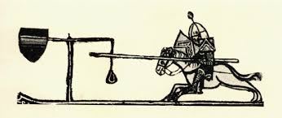
Intuitions of Spelling
isozyme 
ptardine 
prolificity  ⬇
tcharal 
quintain 
hgough
nulliparous
louqt

Slide 97
Intuitions of Spelling
isozyme 
ptardine 
prolificity 
tcharal 
quintain 
hgough 
nulliparous
louqt

Slide 98
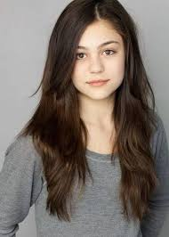
Intuitions of Spelling
isozyme 
ptardine 
prolificity 
tcharal 
quintain 
hgough 
nulliparous  (female with no offspring)
louqt

Slide 99
Intuitions of Spelling
isozyme 
ptardine 
prolificity 
tcharal 
quintain 
hgough 
nulliparous 
louqt 

Slide 100
Intuitions of Spelling
Your good intuitions show that much knowledge of spelling comes from exposure, and not just from explicitly study
Explicit study and exposure support each other in complementary ways
Explicit study allows your students to understand more of the language they hear/read
Exposure reinforces and enhances explicit learning

Slide 101
Vocabulary is More than Single Words
There is a lot of phrasal vocabulary
- Several hundreds of thousands
- As many as there are single words

Slide 102
Phrasal Vocabulary is Important for Language Use
Formulaic sequences are used for functional purposes:
polite request → Would you please X?
→ Would you mind Xing?

Slide 103
Phrasal Vocabulary is Important for Language Use
Facilitating interpersonal interaction:
phatic phrases → Nice weather today
backchannels → Did you really?
How interesting

Slide 104
Phrasal Vocabulary is Important for Language Use
Discourse Organization → in conclusion
in other words
as I was saying

Slide 105
Phrasal Vocabulary is Important for Language Use
Technical phrases → blood pressure is 140 over 60
cleared to land

Slide 106
Phrasal Vocabulary is Important for Language Use
Any vocabulary program will have to focus on phrasal vocabulary as well as single words
The most frequent and usable phrases are worth teaching explicitly
But most will probably need to be learned from extensive exposure

Slide 107
How Do We Teach All These Words?

Slide 108
Balanced Curriculum:
Four Strands
Paul Nation
Language-focused
learning
Meaning-focused input
Meaning-focused output
Fluency
development
Give 25% of lesson time to each strand

Slide 109
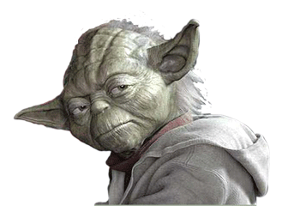
May the Lexicon be with you

Slide 110
☞
www.norbertschmitt.co.uk
110

